Slide 1
Infrastructure as Code
in Azure
Juan Manuel Servera
Spain OCP Sr CSA
Laura Nicolás
Spain OCP CSA

Slide 2
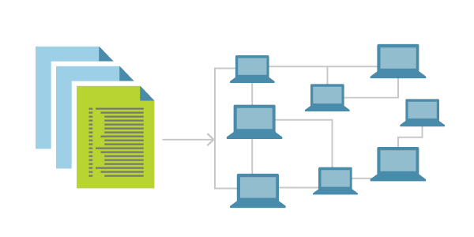
Overview

Slide 3
What is Infrastructure as Code?
Infrastructure as Code (IaC) is the process of managing and provisioning computer data centers through machine-readable definition files
Infrastructure is described using a high-level configuration syntax. This allows a blueprint of your datacenter to be versioned and treated as you would any other code. Additionally, infrastructure can be shared and re-used.
Provide a codified workflow to create infrastructure
Expose a workflow for managing updates to existing infrastructure
Integrate with application code workflows (Git, SCM, Code Review)
Provide modular, sharable components for separation of concerns
Notes:
There are other and overlapping tools out there.
Most tools combine plan and execution
One tool that can deploy to multiple platforms
Can represent infra and CDN or DNS services, etc…

Slide 4
What Is Infrastructure as (from) Code?
Infrastructure as code (IaC) is an approach to infrastructure automation based on practices from software development.
It emphasizes consistent, repeatable routines for provisioning and changing systems and their configuration.
Changes are made to definitions and then rolled out to systems through unattended processes that include thorough validation.

Slide 5

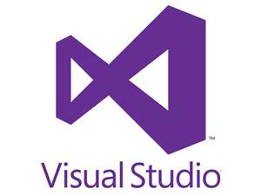
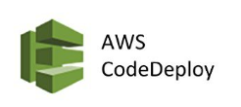





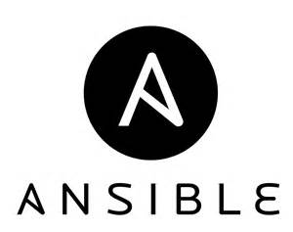




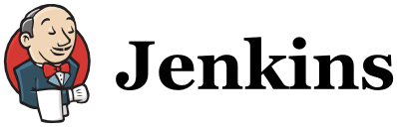



Tooling Categories
Tools and Technologies
Provisioning
Operational Config
Cont. Integration / Deploy
Platform
IT Ops
App/Dev/Ops

Slide 6
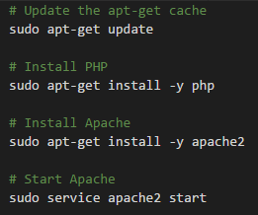
Scripting
You take manual work and break it down into steps
Choose your favorite
scripting language
Define each of those
steps in code
Execute that script
Notes:
The great thing about ad hoc scripts is that you can use popular, general-purpose programming languages and you can write the code however you want.
The terrible thing about ad hoc scripts is that you can use popular, general-purpose programming languages and you can write the code however you want.

Slide 7
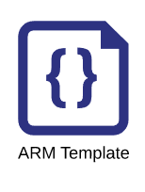


Provisioning Tools
Provisioning tools such as Terraform, Azure ARM Templates, AWS CloudFormation and OpenStack Heat are responsible for creating the servers themselves.
You can use this tools not only create servers, but also other resources such as databases, load balancers, firewall settings, storage, etc.
Notes:
“Every other aspect of your platform” – Since this depended on terraform providers which are open-sourced, not every resource or platform out there is available.

Slide 8


Configuration Management Tools
PowerShell DSC, Chef, Puppet, Ansible and SaltStack are all configuration management tools
Designed to install and manage software on existing servers.
Coding conventions – Consistent & predictable structure, file layout, clearly named parameters, secrets management, etc.
Idempotent Code – Execute the same code repeatedly while producing the same result.
Distribution – Unlike scripts, CM tools are designed specifically for managing large numbers of remote servers.
Notes:
Coding conventions – Enforces a consistent, predictable structure, including documentation, file layout, clearly named parameters, secrets management, and so on.
Idempotence
Code that works correctly no matter how many times you run it is called idempotent code.
Writing an ad hoc script that works once isn’t too difficult; writing an ad hoc script that works correctly even if you run it over and over again is a lot harder.
The light switch example -
Distribution – Ad hoc scripts are designed to run on a single, local machine. Ansible and other configuration management tools are designed specifically for managing large numbers of remote servers.

Slide 9
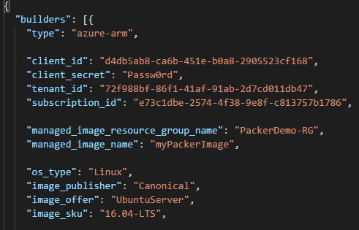


Server Templating Tools
Growing in its popularity, are server templating tools such as Docker, Azure Image Builder, Packer, and Vagrant.
Create an image of a server that captures a fully self-contained “snapshot” of the operating system, the software, the files, and all other relevant details.
Server templating is a key component of the shift to immutable infrastructure.
Server Image
Container Image
Notes:
The idea behind server templating tools is to create an image of a server that captures a fully self-contained “snapshot” of the operating system, the software, the files, and all other relevant details.

Slide 10
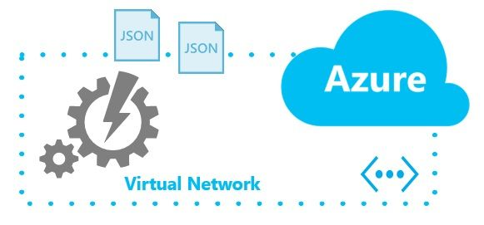
IaC concepts

Slide 11
Idempotency
Idempotency:
Property of certain operations that they can be applied multiple times without changing the result beyond the initial application.
ash
PowerShell
Python
Notes:
Imperative (Procedural) is the “how”. It’s a historical approach which uses the “I don’t trust you, give me the actions” parameters in explicit steps.
Declarative (Functional) is “the what. “This is what I need, I can’t be bothered telling you how to get there” parameters. The how is handled by the interpreter/engine not the administrator. The sys admin describes a desired end state and the tool attempts to reach it.
Regardless of how I get to your house, what really matters is the car I drive. Am I going to drive an imperative stick shift car or a declarative automatic car. Enough metaphors?
Before we dive into code, it’s important to realize that many declarative approaches have some sort of imperative abstraction layer.
An automatic car has some sort of abstraction layer over shifting gears.
In the declarative approach, I’m assuming you have some sort of GPS
Procedural code does not fully capture the state of the infrastructure:
Reading through Ansible templates is not enough to know what’s deployed.
You’d also have to know the order in which those templates were applied.
Had you applied them in a different order, you might have ended up with different infrastructure.
You have to know the full history of every change that has ever happened.
Procedural code limits reusability:
The reusability of procedural code is inherently limited because you have to manually take into account the current state of the infrastructure.
Since that state is constantly changing, code you used a week ago may no longer be usable because it was designed to modify a state of your infrastructure that no longer exists.
As a result, procedural codebases tend to grow large and complicated over time.
With Terraform’s declarative approach, the code always represents the latest state of your infrastructure. At a glance, you can tell what’s currently deployed and how it’s configured, without having to worry about history or timing.
This also makes it easy to create reusable code, as you don’t have to manually account for the current state of the world. Instead, you just focus on describing your desired state.

Slide 12
Imperative vs. Declarative
Imperative (procedural):
Defines specific commands that need to be executed in the appropriate order to end with the desired conclusion.
Bash
PowerShell
Python
New-AzureVM –VM $myVM
New-AzureStorageAccount –StorageAccountName $acct
Set-AzureVNetConfig –ConfigurationPath -Path
Notes:
Imperative (Procedural) is the “how”. It’s a historical approach which uses the “I don’t trust you, give me the actions” parameters in explicit steps.
Declarative (Functional) is “the what. “This is what I need, I can’t be bothered telling you how to get there” parameters. The how is handled by the interpreter/engine not the administrator. The sys admin describes a desired end state and the tool attempts to reach it.
Regardless of how I get to your house, what really matters is the car I drive. Am I going to drive an imperative stick shift car or a declarative automatic car. Enough metaphors?
Before we dive into code, it’s important to realize that many declarative approaches have some sort of imperative abstraction layer.
An automatic car has some sort of abstraction layer over shifting gears.
In the declarative approach, I’m assuming you have some sort of GPS
Procedural code does not fully capture the state of the infrastructure:
Reading through Ansible templates is not enough to know what’s deployed.
You’d also have to know the order in which those templates were applied.
Had you applied them in a different order, you might have ended up with different infrastructure.
You have to know the full history of every change that has ever happened.
Procedural code limits reusability:
The reusability of procedural code is inherently limited because you have to manually take into account the current state of the infrastructure.
Since that state is constantly changing, code you used a week ago may no longer be usable because it was designed to modify a state of your infrastructure that no longer exists.
As a result, procedural codebases tend to grow large and complicated over time.
With Terraform’s declarative approach, the code always represents the latest state of your infrastructure. At a glance, you can tell what’s currently deployed and how it’s configured, without having to worry about history or timing.
This also makes it easy to create reusable code, as you don’t have to manually account for the current state of the world. Instead, you just focus on describing your desired state.

Slide 13
Imperative vs. Declarative
Declarative (functional):
Defines the desired state and the system executes what needs to happen to achieve that desired state.
Terraform
Ansible
ARM
{
"$schema": "https://../deploymentTemplate.json#",
"contentVersion": "1.0.0.0",
"parameters": {},
"variables": {},
"resources": [],
"outputs": {}
}
Notes:
Imperative (Procedural) is the “how”. It’s a historical approach which uses the “I don’t trust you, give me the actions” parameters in explicit steps.
Declarative (Functional) is “the what. “This is what I need, I can’t be bothered telling you how to get there” parameters. The how is handled by the interpreter/engine not the administrator. The sys admin describes a desired end state and the tool attempts to reach it.
Regardless of how I get to your house, what really matters is the car I drive. Am I going to drive an imperative stick shift car or a declarative automatic car. Enough metaphors?
Before we dive into code, it’s important to realize that many declarative approaches have some sort of imperative abstraction layer.
An automatic car has some sort of abstraction layer over shifting gears.
In the declarative approach, I’m assuming you have some sort of GPS
Procedural code does not fully capture the state of the infrastructure:
Reading through Ansible templates is not enough to know what’s deployed.
You’d also have to know the order in which those templates were applied.
Had you applied them in a different order, you might have ended up with different infrastructure.
You have to know the full history of every change that has ever happened.
Procedural code limits reusability:
The reusability of procedural code is inherently limited because you have to manually take into account the current state of the infrastructure.
Since that state is constantly changing, code you used a week ago may no longer be usable because it was designed to modify a state of your infrastructure that no longer exists.
As a result, procedural codebases tend to grow large and complicated over time.
With Terraform’s declarative approach, the code always represents the latest state of your infrastructure. At a glance, you can tell what’s currently deployed and how it’s configured, without having to worry about history or timing.
This also makes it easy to create reusable code, as you don’t have to manually account for the current state of the world. Instead, you just focus on describing your desired state.

Slide 14
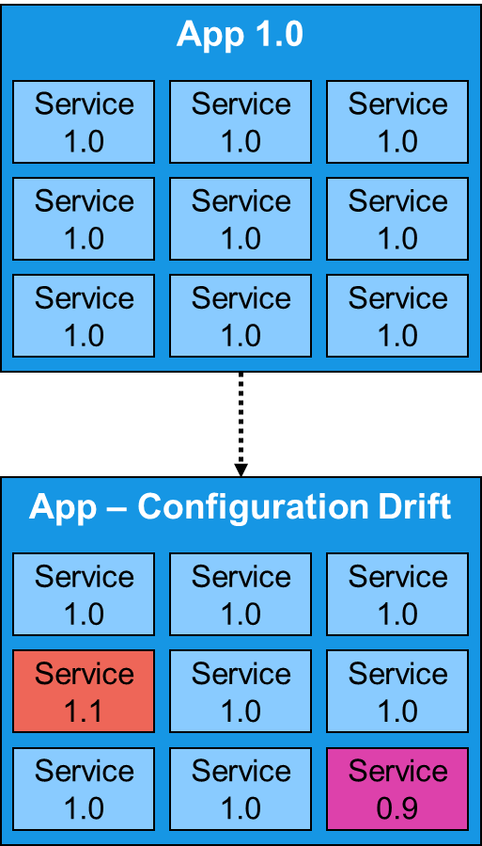
Mutable vs Immutable Infrastructure
Infrastructure will be continually updated, patched and tuned to meet the ongoing needs of the purpose it serves.
CM tools such as Chef or Puppet typically default to a mutable infrastructure paradigm.
Over time, as you apply more and more updates, each server builds up a unique history of changes.
As a result, each service becomes slightly different than all the others, leading to configuration drift and can result to bugs which can be difficult to diagnose and reproduce.
Notes:
For example, if you tell Chef to install a new version of OpenSSL, it’ll run the software update on your existing servers and the changes will happen in place.
Mutable Infrastructure
Essentially, it means the infrastructure will be continually updated, tweaked, and tuned to meet the ongoing needs of the purpose it serves.
Configuration management tools such as Chef, Puppet, Ansible, and SaltStack typically default to a mutable infrastructure paradigm.
Over time, as you apply more and more updates, each server builds up a unique history of changes.
As a result, each server becomes slightly different than all the others, leading to subtle configuration bugs that are difficult to diagnose and reproduce.

Slide 15
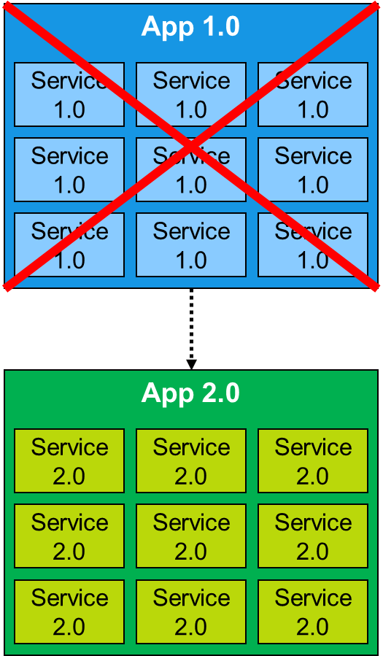
Mutable vs Immutable Infrastructure
Using code to deploy machine images created by Docker, Packer or Azure Image Builder result “changes” to be deployments of a completely new app version.
Reduces the likelihood of configuration drift bugs, makes it easier to version software.
Automated testing are more effective, as an immutable image that passes your tests in the test environment is likely to behave the same way in the production.
Notes:
Using the term “immutable” to describe this pattern can be misleading. “Immutable” means that a thing can’t be changed, so a truly immutable server would be useless. As soon as a server boots, its runtime state changes—processes run, entries are written to logfiles, and application data is added, updated, and removed.
It’s more useful to think of the term “immutable” as applying to the server’s configuration, rather than to the server as a whole. This creates a clear line between configuration and data. It forces teams to explicitly define which elements of a server they will manage deterministically as configuration and which elements will be treated as data.
A good example will be this days mobile phones that have batteries that cannot be replaced. So instead of upgrading devices in the field, those devices are now immutable and the whole device needs to be replaced. This provides a level of consistency that makes support easier.
Immutable Infrastructure
If you’re using a provisioning tool such as Terraform to deploy machine images created by Docker or Packer, then most “changes” are actually deployments of a completely new app version.
Since every deployment uses immutable images on fresh servers, this approach reduces the likelihood of configuration drift bugs, makes it easier to know exactly what software is running on each server.
It also makes your automated testing more effective, as an immutable image that passes your tests in the test environment is likely to behave exactly the same way in the production environment.
Blue-green deployment is a technique that reduces downtime and risk by running two identical production environments called Blue and Green.

Slide 16

Azure Resource Manager ARM

Slide 17










Azure Resource Manager Architecture
Microsoft Azure
ARM Key Takeaways
A resource always belongs to a Resource Group (RG)
RG is a unit of management
RBAC support
Custom policies
Azure Subscription
Resource Group
LOB App
Resource Group
IaaS Workload
Resource Providers
Azure Resource Manager (ARM)
REST API Endpoints

Slide 18
Data Plane vs Control Plane
Control Plane Operations
Operations involves to management plane
Create a VM
Restart a VM
Update Virtual Network with a new subnet etc.
Data Plane Operations
Any operation that doesn’t go through the Azure Management plane
Accessing a web site
Copying a blob from a storage account
Accessing a Public IP address to RDP or SSH into the Virtual Machine.

Slide 19
Abstractions on top of platform
Tooling
CLI
PowerShell
ARM templates
SDKs
Third party IaC tooling
Terraform
FarmerIO

Slide 20
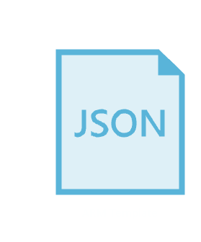
ARM Templates

Slide 21

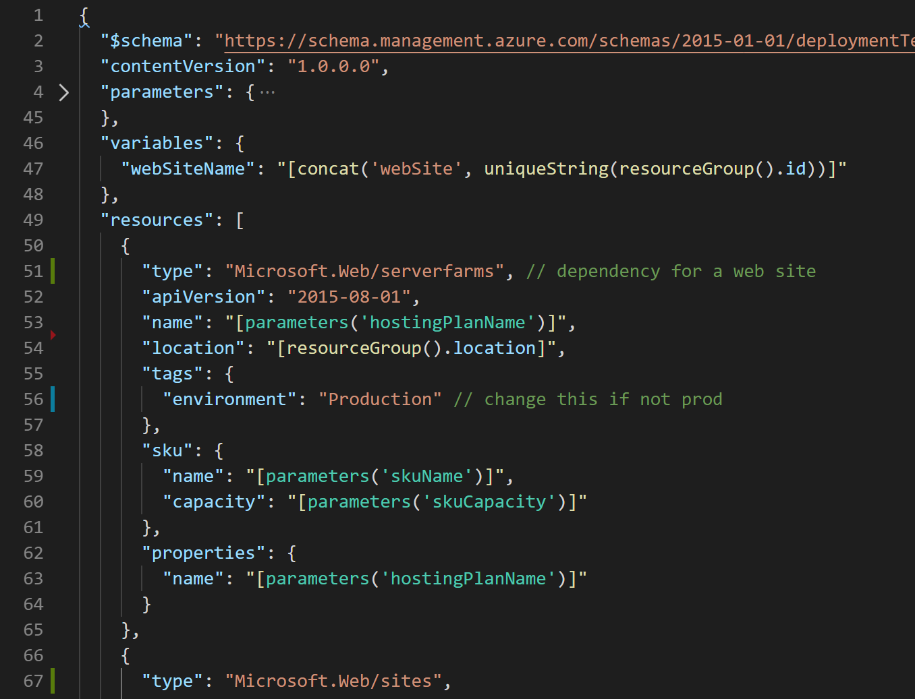




What are ARM Templates?
Declarative files for creating Azure resources in a reliable, repeatable and auditable way.
Infrastructure as Code
Define Azure resources using text files.
Declarative Syntax
Declare how the resources should be and Azure Resource Manager “makes it so”.
JSON
ARM Templates are JSON format text files. Edit them in Visual Studio Code (or other text editors). Version control them.
Meta-Language
Contains some programming language constructs such as functions and loops.
➔
https://docs.microsoft.com/en-us/azure/templates/
Notes:
Need a slide here on other “Deployment” types like terraform and how they compare. Ie. logic to perform ARM puts it handled on client slide vs server side. No validate/preflight.

Slide 22
ARM Template Deployments
SQL-A
Instantiation of repeatable config.
Configuration → Resource Group
What?
Source file, can be checked-in
Specifies resources, dependencies and connections
Parameterized input/output
Why?
Ensure Idempotency
Simplify orchestration (dependencies, nested templates)
Website
[SQL CONFIG] VM (2x)
DEPENDS ON SQL
DEPENDS ON SQL
SQL - A
Website
Virtual
Machines
SQL
C
ONFIG
Notes:
Written in JSON, describes entities
Template execution engine can interpret dependencies and relationships and orchestrate the deployment of the resources for you
Resources at the bottom of the stack are deployed first
Idempotent, can redeploy and get the same goal state
Parameterized input and output – reuse template in different environments
Templates are represented in the gallery

Slide 23
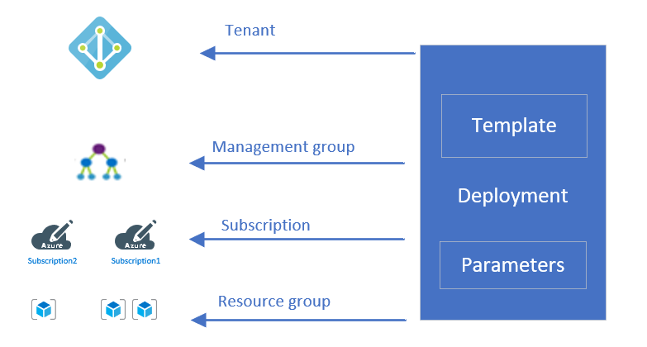
Deployment Scopes

Slide 24
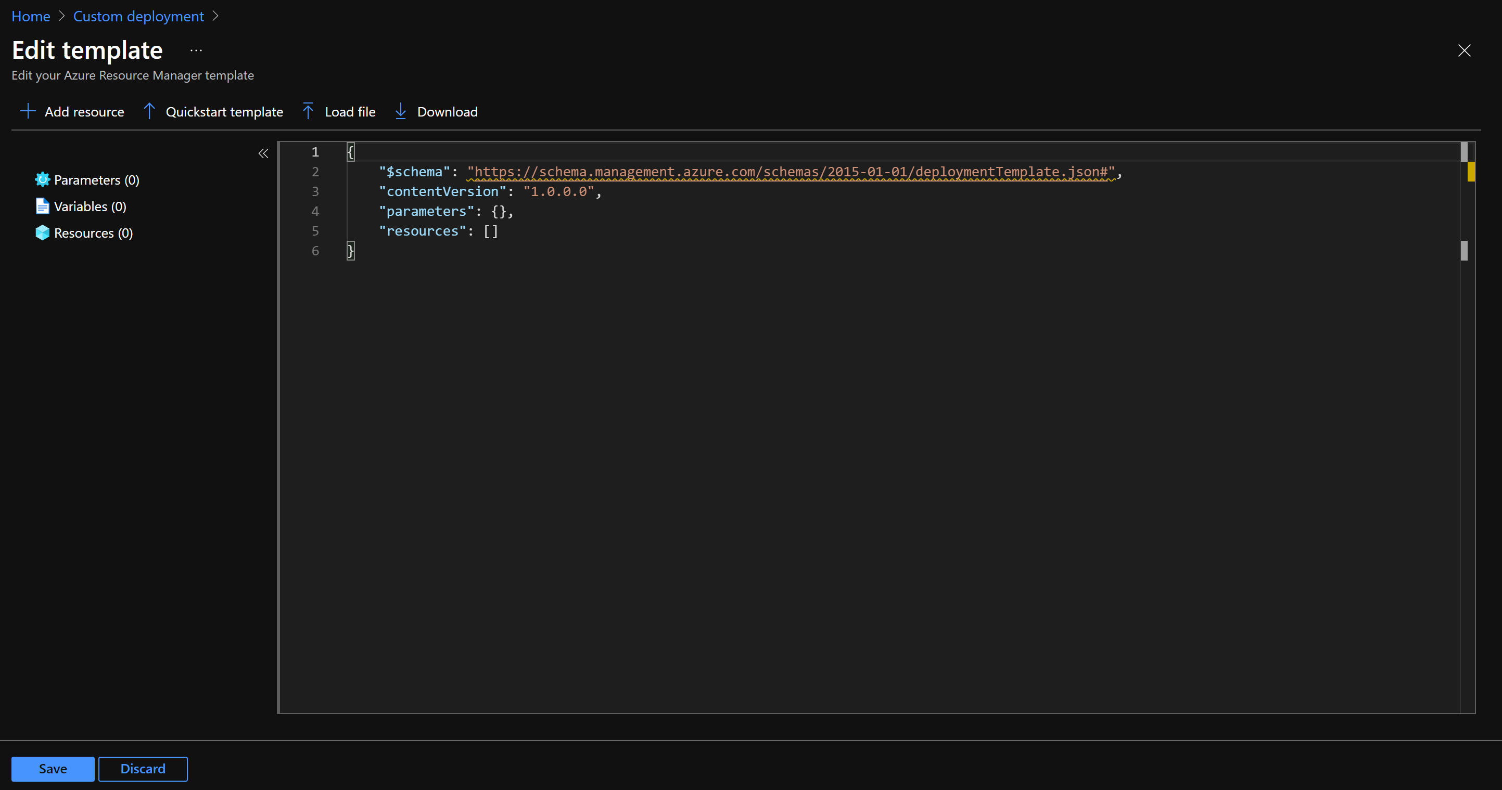

Template Deployment
Resource Group scope:
New-AzResourceGroupDeployment -ResourceGroupName <resource-group-name> -TemplateFile <path-to-template>
Subscription scope:
New-AzSubscriptionDeployment -Location <location> -TemplateFile <path-to-template>
Management Group scope:
New-AzManagementGroupDeployment -Location <location> -TemplateFile <path-to-template>
Tenant scope:
New-AzTenantDeployment -Location <location> -TemplateFile <path-to-template>
Resource Group scope:
az deployment group create --resource-group <resource-group-name> --template-file <path-to-template>
Subscription scope:
az deployment sub create --location <location> --template-file <path-to-template>
Management Group scope:
az deployment mg create --location <location> --template-file <path-to-template>
Tenant scope:
az deployment tenant create --location <location> --template-file-TemplateFile <path-to-template>
Resource Group scope:
PUT https://management.azure.com/subscriptions/{subscriptionId}/resourcegroups/{resourceGroupName}/providers/Microsoft.Resources/deployments/{deploymentName}?api-version=2020-10-01
Subscription scope:
PUT https://management.azure.com/subscriptions/{subscriptionId}/providers/Microsoft.Resources/deployments/{deploymentName}?api-version=2020-10-01
Management Group scope:
PUT https://management.azure.com/providers/Microsoft.Management/managementGroups/{groupId}/providers/Microsoft.Resources/deployments/{deploymentName}?api-version=2020-10-01
Tenant scope:
PUT https://management.azure.com/providers/Microsoft.Resources/deployments/{deploymentName}?api-version=2020-10-01
Azure Portal
PowerShell
Azure CLI
REST API
GitHub Hyperlink
[![Deploy to Azure](https://aka.ms/deploytoazurebutton)](https://portal.azure.com/#create/Microsoft.Template/uri/https%3A%2F%2Fraw.githubusercontent.com%2FAzure%2Fazure-quickstart-templates%2Fmaster%2F101-storage-account-create%2Fazuredeploy.json)

Slide 25
Template Syntax
Four top level sections
Parameters – user input for the template
Variables – allows model reuse and “mappings” (e.g. different image based on region)
Resources – models all the resources in the resource group
Outputs – captures information from the execution (e.g. DNS name for the created blog)
{
"$schema": "https://../deploymentTemplate.json#",
"contentVersion": "1.0.0.0",
"parameters": {},
"variables": {},
"resources": [],
"outputs": {}
}

Slide 26
Template Syntax - Parameters
Parameters
Secure – not saved and not logged for passwords
Allowed Values – array of allowed values for example regions
Default Value – used if not specified during deployment
Constraints – include length or integer constraints for values
Description: additional metadata
"parameters": {
"demoString": {
"type": "string"
},
"demoInt": {
"type": "int"
},
"demoBool": {
"type": "bool"
}
}

Slide 27
Template Syntax - Variables
Variables
Are used to simplify the template
Avoids repeating complicated expressions
You can use functions to modify a parameter in a variable
"parameters": {
"inputValue": {
"defaultValue": "deployment parameter",
"type": "string"
}
},
"variables": {
"stringVar": "myVariable",
"concatToVar": "[concat(variables('stringVar'), '-addtovar') ]",
"concatToParam": "[concat(parameters('inputValue'), '-addtoparam')]"
}

Slide 28
Template Syntax - Functions
There are user-defined or ARM template functions
Standard functions are classified into:
Array
Comparison
Date
Deployment
Logical
Numeric
Objetc
Resource
String
"functions": [
{
"namespace": "<namespace-for-functions>",
"members": {
"<function-name>": {
"parameters": [
{
"name": "<parameter-name>",
"type": "<type-of-parameter-value>"
}
],
"output": {
"type": "<type-of-output-value>",
"value": "<function-return-value>"
}
}
}
}
],

Slide 29
Template Syntax - Resources
Resources can have child resources that only exist within the context of another
You can specify dependencies to deploy in a specific order otherwise will be created in parallel
You can use ARM template extensions to provide post-deployment configurations and automation tasks on the created resources. For example: VM extensions.
"parameters": {
"storageAccountName": {
"type": "string",
"minLength": 3,
"maxLength": 24
}
},
"resources": [
{
"type": "Microsoft.Storage/storageAccounts",
"apiVersion": "2019-06-01",
"name": "[parameters('storageAccountName')]",
...
}
]

Slide 30
Template Syntax - Resources
Resources can have child resources that only exist within the context of another
You can specify dependencies to deploy in a specific order otherwise will be created in parallel
You can use ARM template extensions to provide post-deployment configurations and automation tasks on the created resources. For example: VM extensions.
"parameters": {
"storageAccountName": {
"type": "string",
"minLength": 3,
"maxLength": 24
}
},
"resources": [
{
"type": "Microsoft.Storage/storageAccounts",
"apiVersion": "2019-06-01",
"name": "[parameters('storageAccountName')]",
...
}
]

Slide 31
Template Syntax - Outputs
Use outputs to return values from deployed resources
Some examples may include public IP addresses or URLs.
Can be used in linked templates as input for the next deployment or in CI/CD pipelines
{
"$schema": "https://schema.management.azure.com/schemas/2019-04-01/deploymentTemplate.json#",
"contentVersion": "1.0.0.0",
"variables": {
"user": {
"user-name": "Test Person"
}
},
"resources": [
],
"outputs": {
"nameResult": {
"type": "string",
"value": "[variables('user')['user-name']]"
}
}
}

Slide 32
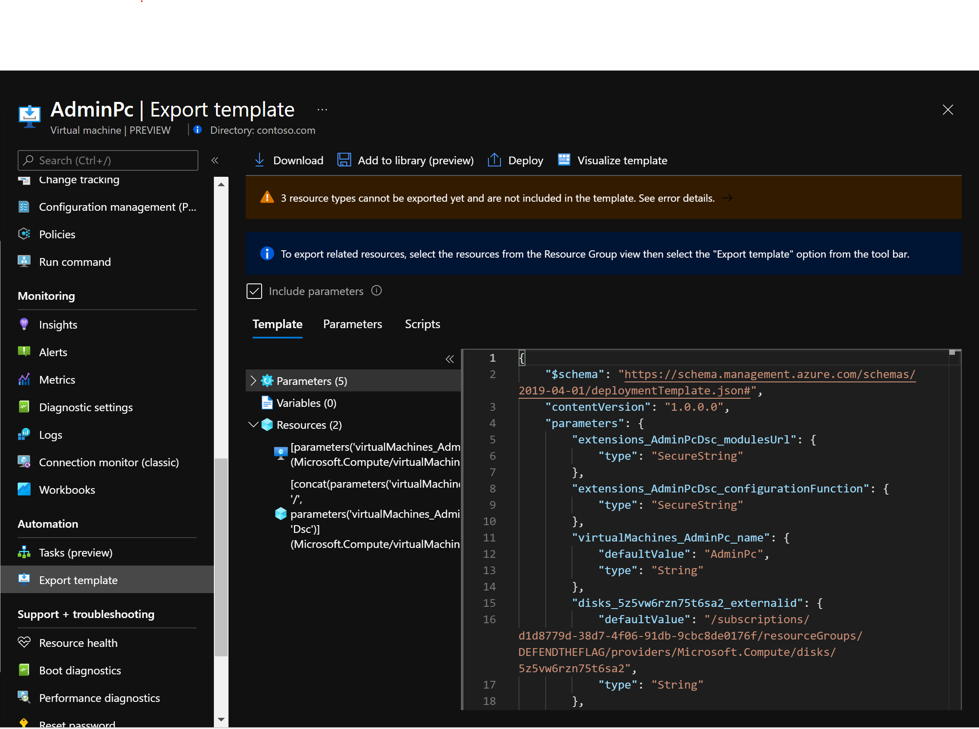
Creating your ARM template
You can get an ARM template for your deployment from the Azure Portal

Slide 33
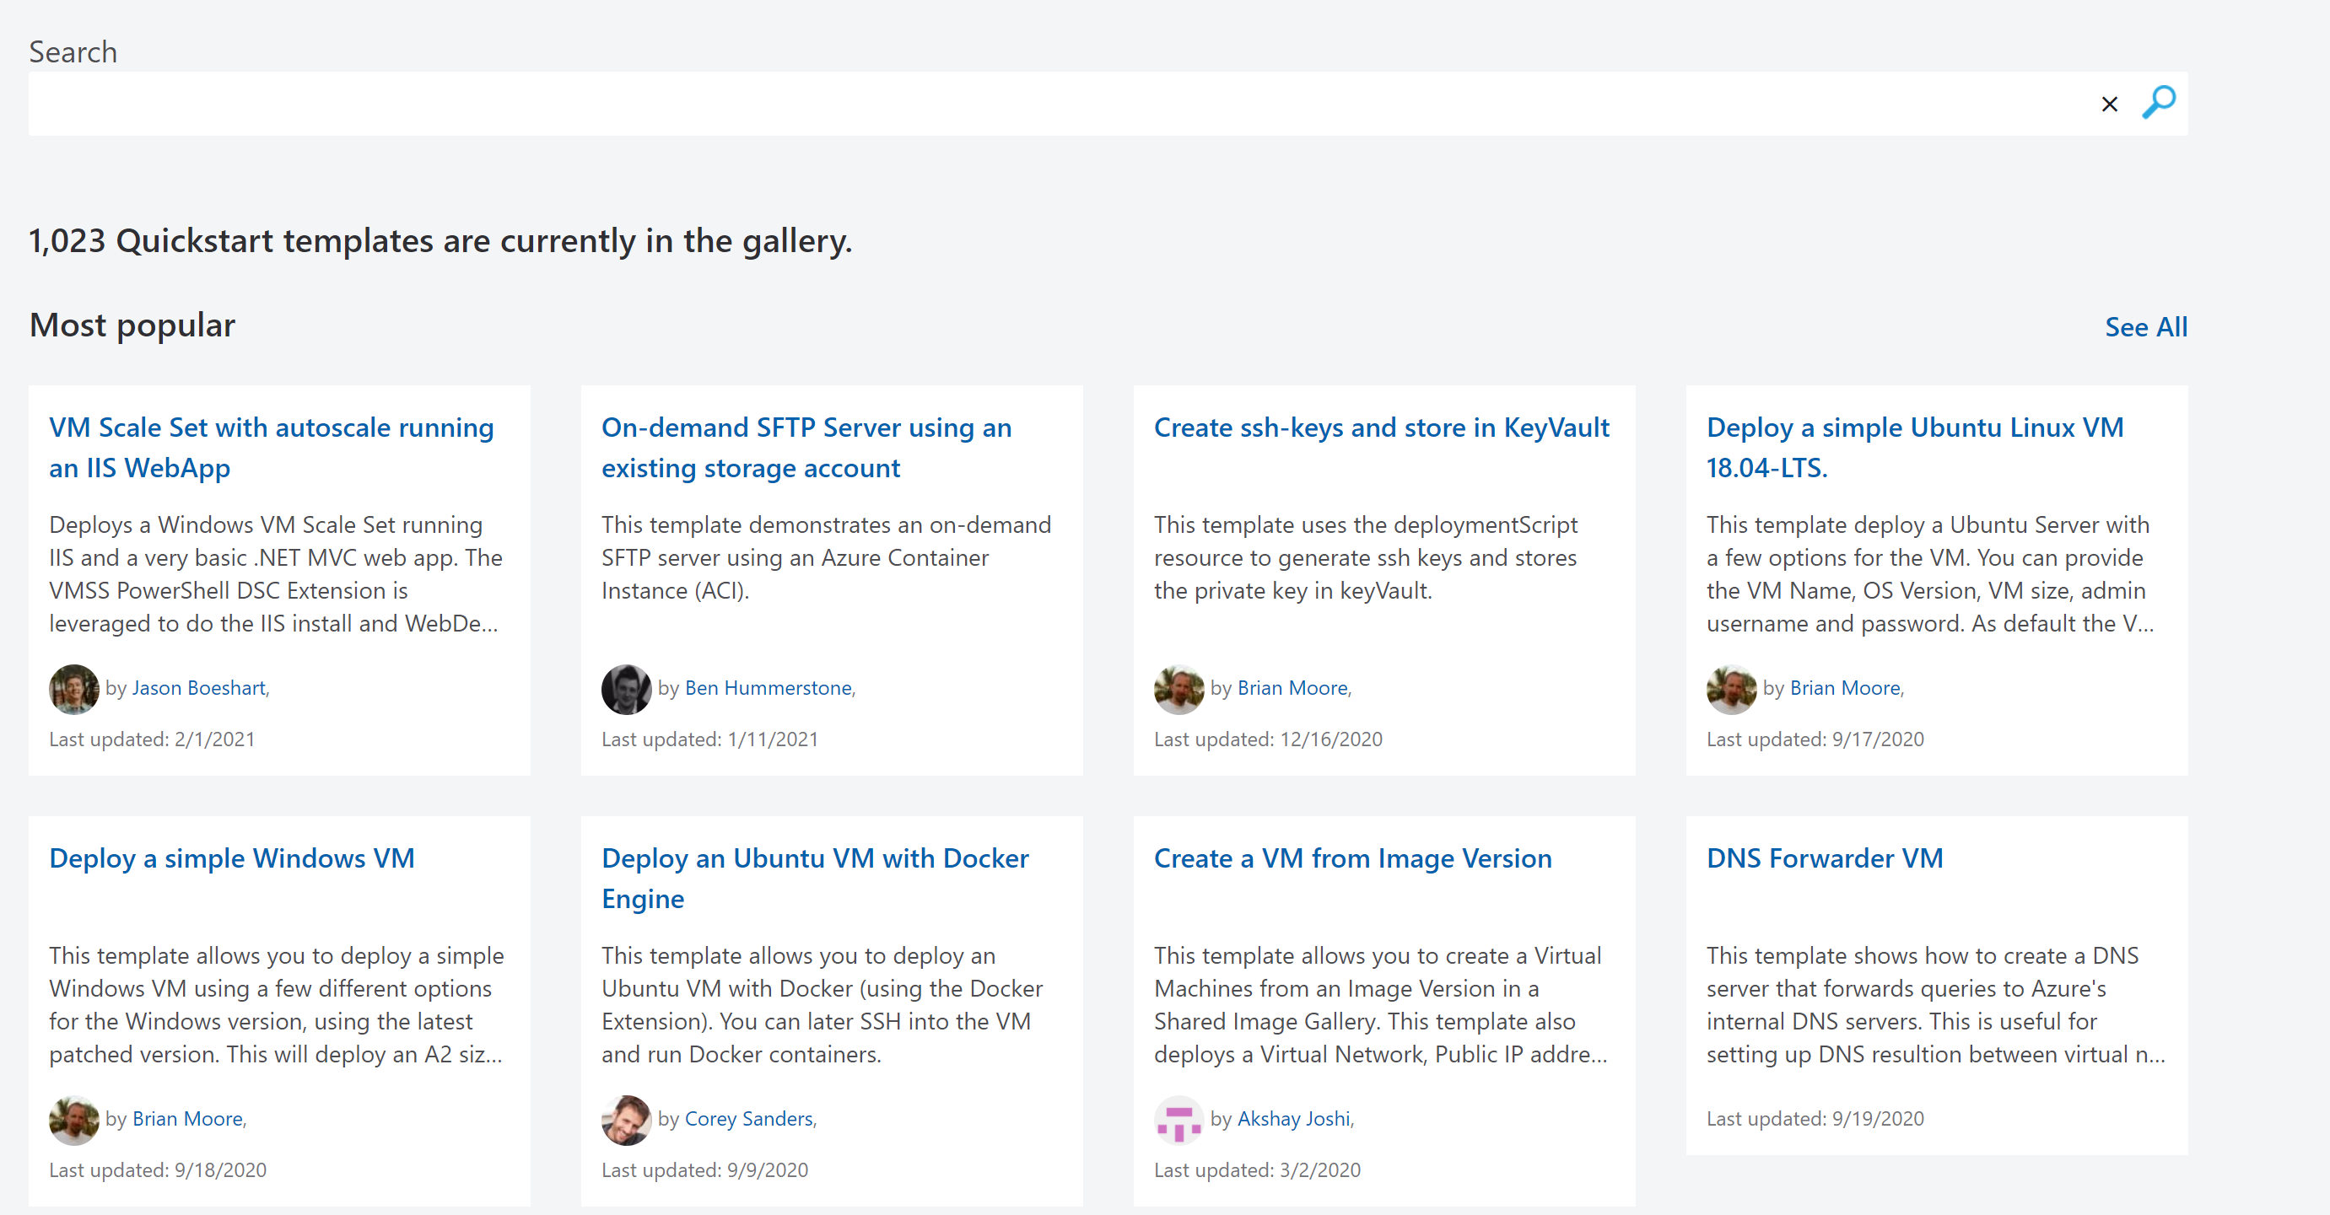
Creating your ARM template
Leverage Azure Quickstart Templates:
Azure Quickstart Templates (microsoft.com)

Slide 34
Project ‘Bicep’
Simple declarative language to provision infrastructure on Azure
Bicep Language
Transpiles to ARM Templates: Leverage ARM template knowledge and investments.
bicep build
ARM Templates
Modular: Abstract common blocks of config into reusable elements
az deployment group create
Azure Resource Manager
Open Source: Transparency and community
Day 1 Provider Coverage: All resources including preview services supported on day 1
Storage
Compute
Network
Identity
…
ARC
K8s
GitHub
…
+250 Resource Providers
3rd party extensibility
Platform Integrations: Integrated with Azure Policy, Blueprints, TemplateSpecs, Service Catalog etc.
Learn more: aka.ms/Bicep
Currently at 0.3 release: 1:1 with ARM templates, loops, decompile
Notes:
Follow the onboarding steps found here: https://github.com/Azure/bicep/blob/master/docs/installing.md
Basic template tutorial here: https://github.com/Azure/bicep/blob/master/docs/tutorial/01-simple-template.md
Provide Feedback by filing any syntax improvements, bugs or feature request here: https://github.com/Azure/bicep/issues

Slide 35
Bicep to ARM Template
{
"$schema": "https://schema.management.azure.com/schemas/2019-04-01/deploymentTemplate.json#",
"contentVersion": "1.0.0.0",
"parameters": {
"baseName": {
"type": "string",
"defaultValue": "myaccount"
}
},
"functions": [],
"variables": {
"uniqueName": "[concat(parameters('baseName'), uniqueString(resourceGroup().id))]",
"storageAccountName": "[substring(format('storage{0}', variables('uniqueName')), 0, 23)]",
"location": "[resourceGroup().location]"
},
"resources": [
{
"type": "Microsoft.Storage/storageAccounts",
"apiVersion": "2019-06-01",
"name": "[variables('storageAccountName')]",
"location": "[variables('location')]",
"kind": "StorageV2",
"sku": {
"name": "Standard_LRS"
}
}
]
}
param baseName string = 'myaccount'
var uniqueName= concat(baseName, uniqueString(resourceGroup().id))
var storageAccountName=substring('storage${uniqueName}',0, 23)
var location=resourceGroup().location
resource stg 'Microsoft.Storage/storageAccounts@2019-06-01' = {
name: uniqueName
location: location
kind: 'StorageV2'
sku: {
name: 'Standard_LRS'
}
}

Slide 36
Bicep
Bicep is an open source Domain Specific Language (DSL)
It is a transparent abstraction to ARM
Simple and modular syntax that transpiles into an ARM Template
It simplifies ARM templates for deployments at scale.
It is declarative language
Bicep Language
bicep build
ARM Templates
az deployment group create
Azure Resource Manager
resource stg 'Microsoft.Storage/storageAccounts@2019-06-01' = {
name: 'uniquestorage001' // must be globally unique
location: 'eastus’
kind: 'Storage’
sku: {
name: 'Standard_LRS’
}
}
Storage
Compute
Network
Identity
…
ARC
K8s
GitHub
…
+250 RPs
3rd party extensibility
Learn more: aka.ms/Bicep

Slide 37
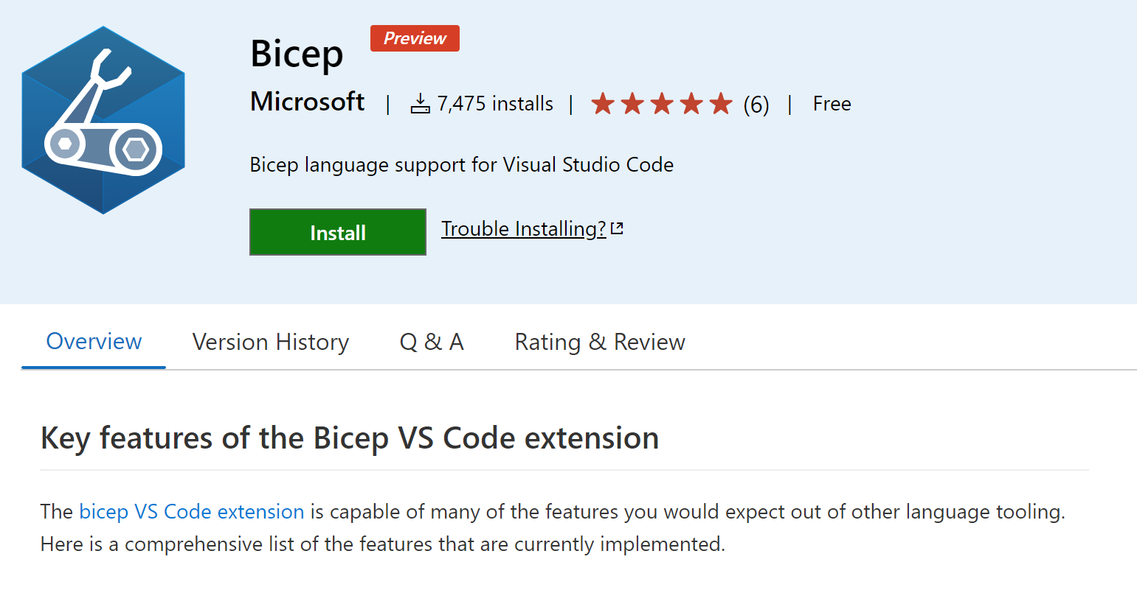
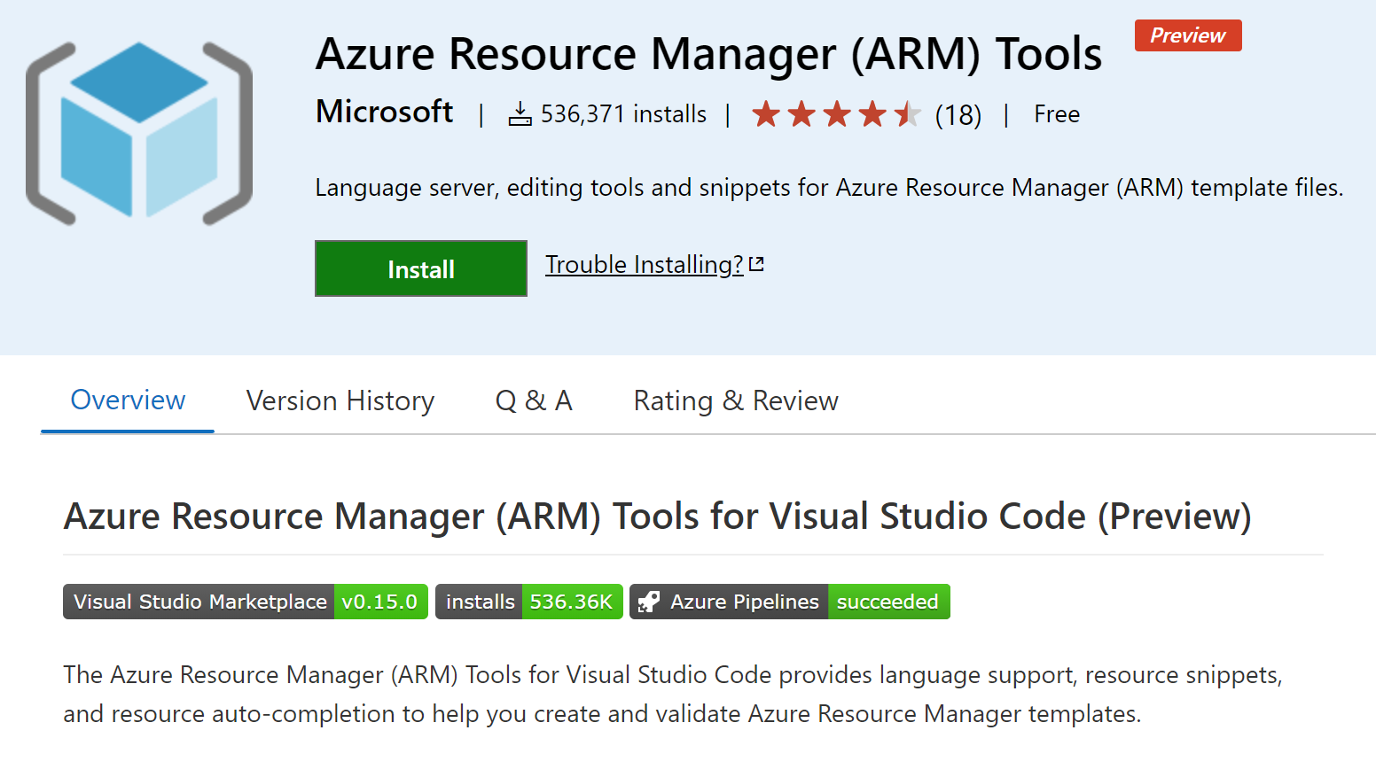
ARM Deployments |
Author
Validate
Deploy
Manage
Video Overview

Slide 38
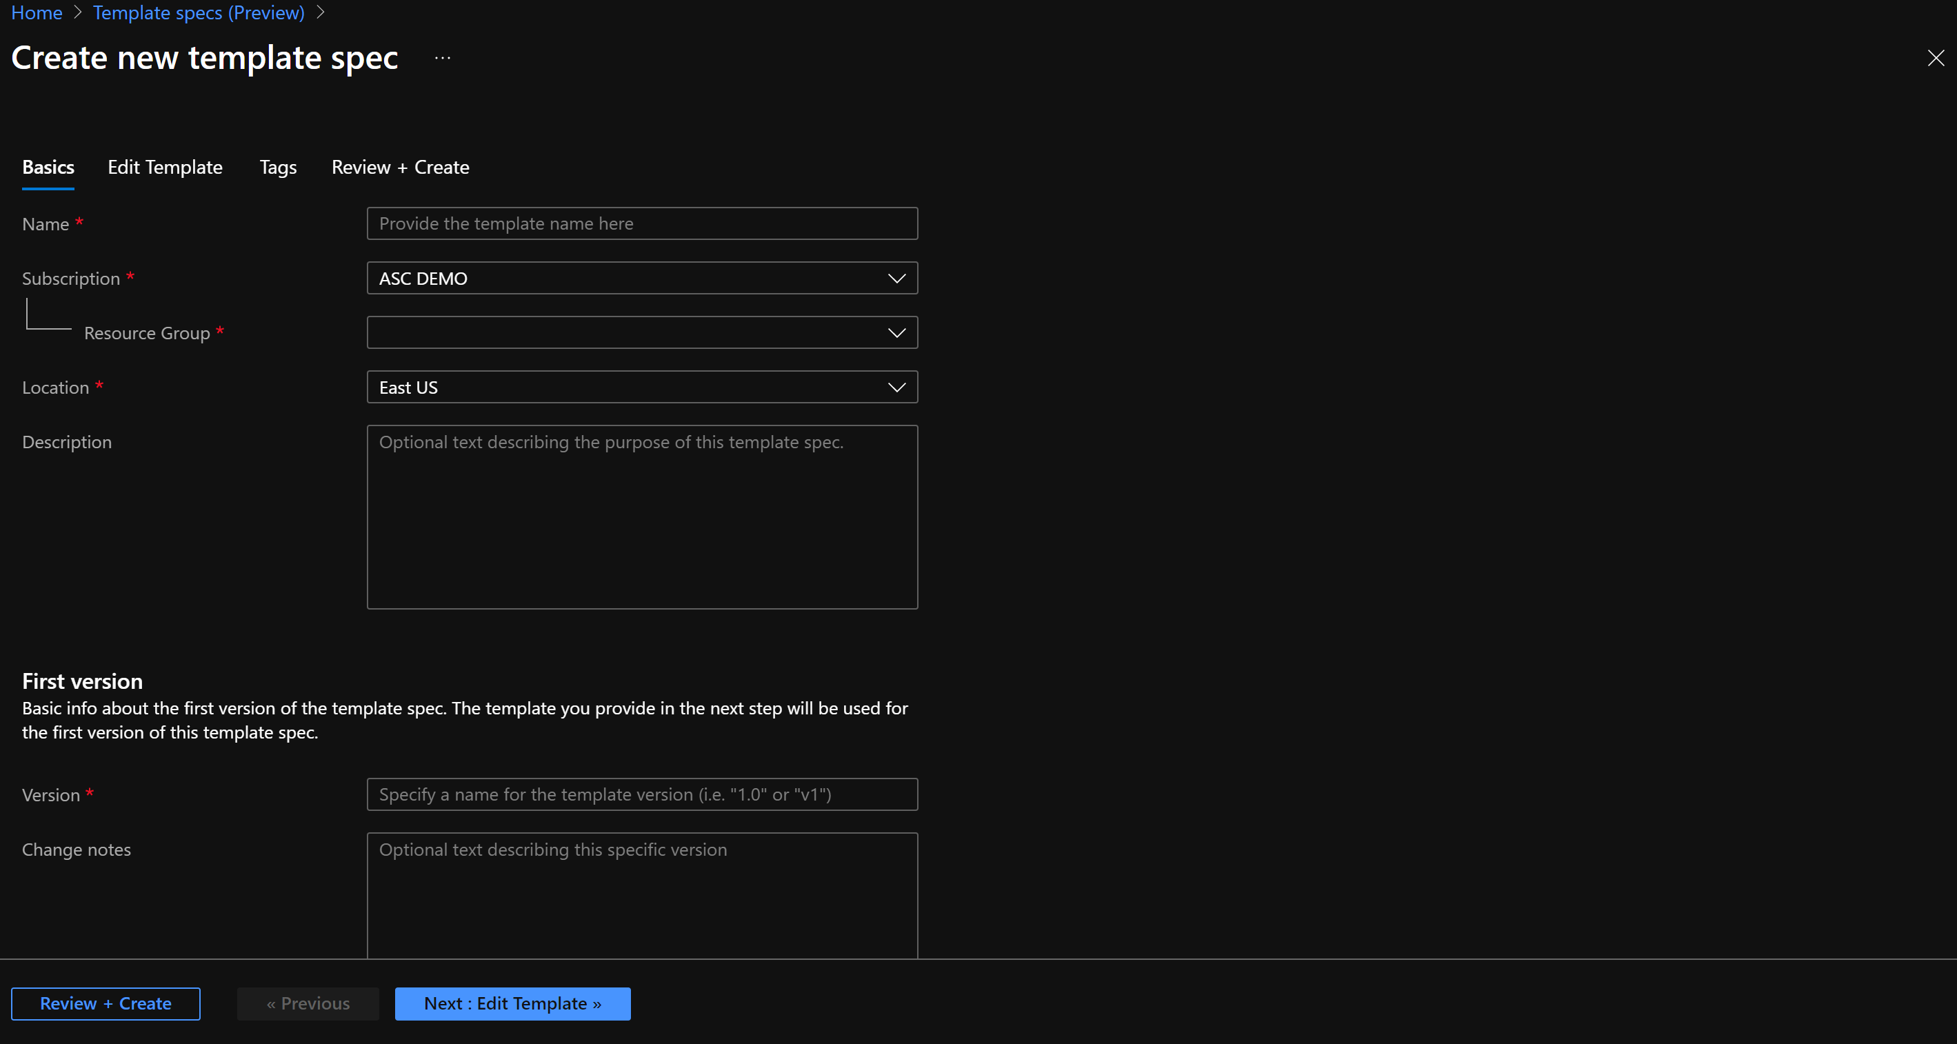
ARM template specs (preview)
A template spec is a resource type for storing an Azure Resource Manager template (ARM template) in Azure
This resource type enables you to share ARM templates with other users in your organization.
You can use Azure Azure RBAC to share the template spec.
Supports versioning
Uses standard ARM templates
You can integrate with DevOps pipelines.

Slide 39
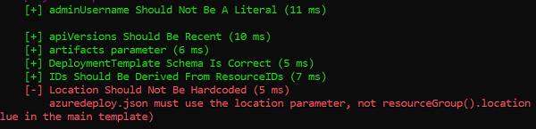
ARM template test toolkit
Checks whether your template uses recommended practices.
When your template isn't compliant with recommended practices, it returns a list of warnings with the suggested changes.
The test toolkit provides a set of default tests. These tests are recommendations but not requirements.
You can create your own tests

Slide 40

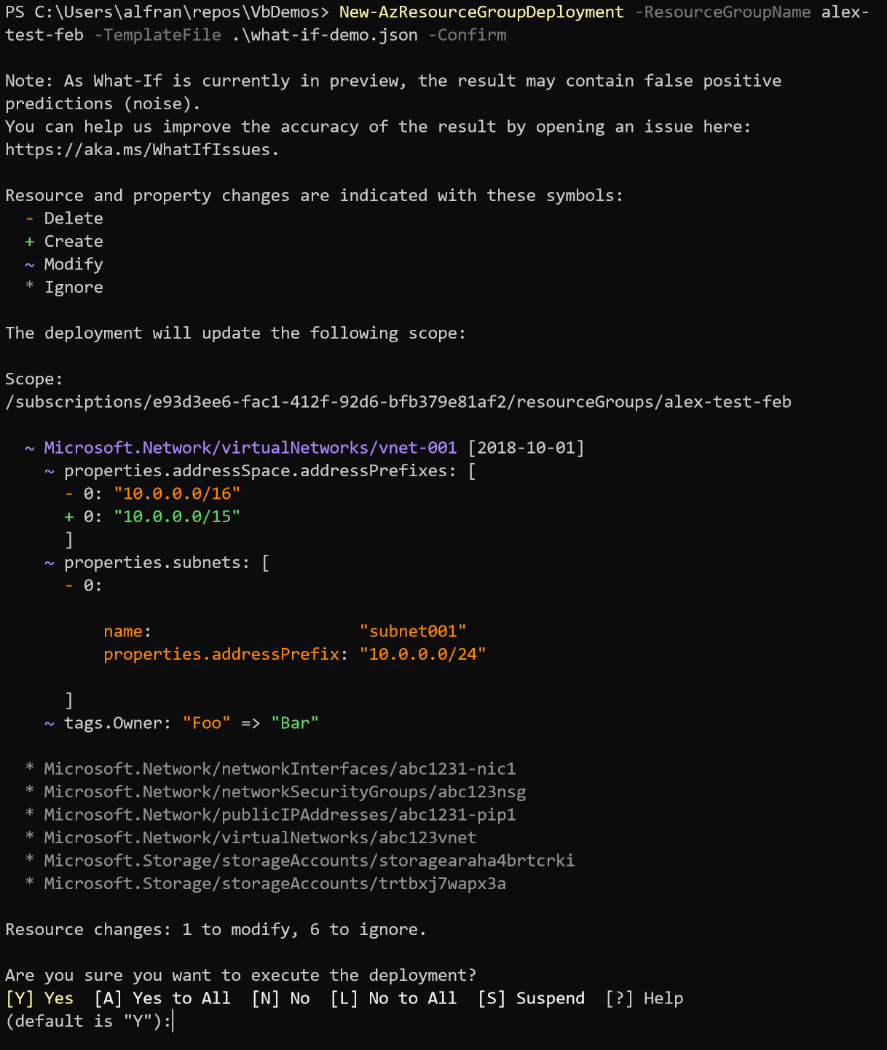
ARM Deployments |
Author
Validate
Deploy
Manage
What-IF
Pre-deployment impact assessment
Determine the impact of my deployment: Evaluate the impact of a change (What-IF) and detect drifts. Identifies what resources are going to be added, delete or modified.
Our Focus: Noise reduction – burning down the list of most popular resource types
Track progress: https://github.com/Azure/arm-template-whatif/issues/38
cmdlet update:
New –WhatIf & -Confirm behavior (-Confirm is *really* nice)
Get-AzDeploymentPlan for PS object and programmatic interaction

Slide 41

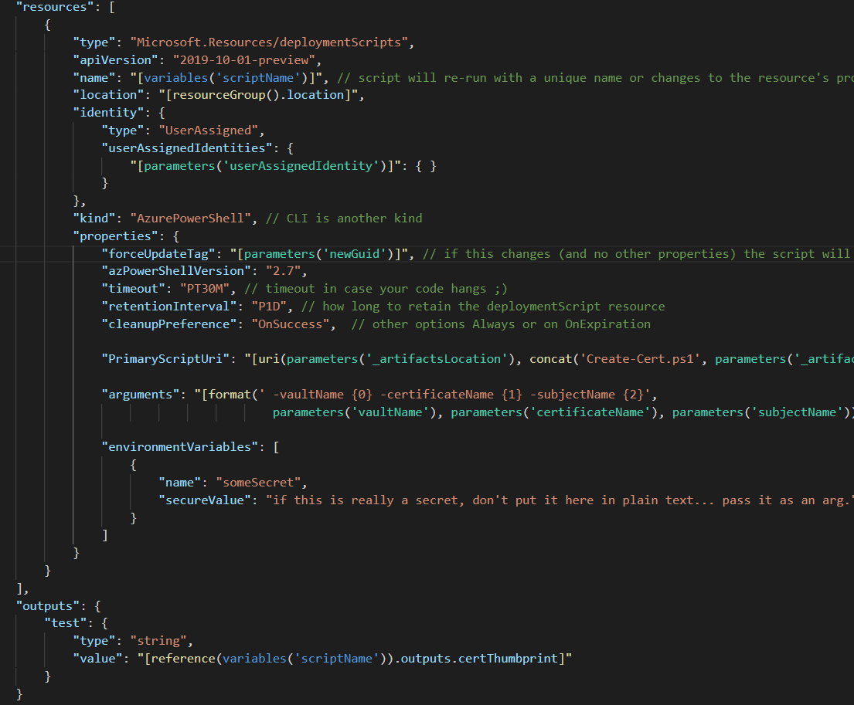
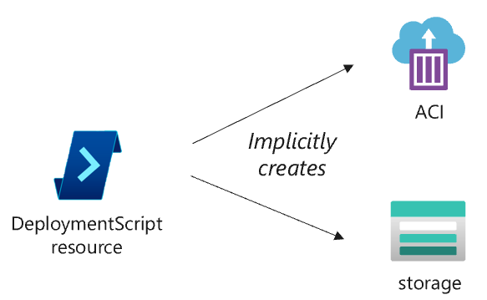
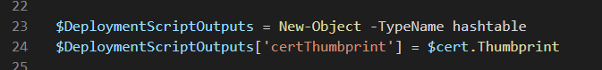
ARM Deployments |
Author
Validate
Deploy
Manage
Deployment Scripts
Completing last mile scenarios using PowerShell and Bash from within your ARM Template
Completing last mile scenarios: DeploymentScripts resource will execute any PowerShell or Bash script as part of your template deployment.
How it works:
Resource Provider spins up a linux container (via ACI)
When the DeploymentScript finishes execution, storage + ACI are immediately cleaned up
stdout and declared outputs are stored in the DeploymentScript Resource
DeploymentScript Resource will be removed after provided expiration time
Notes:
CLI Support
Portal/CLI/PS experience for reading, deleting
Need more people trying this, should be available to everyone (we are just not talking about that very loudly)
What is the timeline for public preview and how we are “branding” this release?

Slide 42
Benefits of using ARM Templates vs. other Infra as Code solutions
Resource Provider coverage from day one
1
When a new Azure Resource is released there is an ARM Template available
ARM Templates
Non-template based infra as code
Deployments are a tracked object in the Azure Portal
2
View the ARM Template deployment in the AzPortal, not the case for other infra as code solutions
One ARM Template submitted
Multiple Imperative PUT Calls
Pre-Flight Checks
3
ARM Deployments have pre-flight checks to make sure the template will deploy successfully
Azure Policy Remediations
4
ARM
If a customer is using Azure Policy the remediations performed for non-compliant resources are done through ARM Templates.
Concurrent Executions
5
Resource Providers
3rd party IaC solutions do not allow current runs, plans or applies. No state management in ARM
Blueprint\Service Catalog\
Services
6
Ability to publish approved set of templates and reference architectures across your organization. ISO, NIST, HIPAA etc.
Notes:
Cannot pre-flights imperative puts, handling sequencing, lack of provider availability and having a tracked deployment object which you can reference.

Slide 43
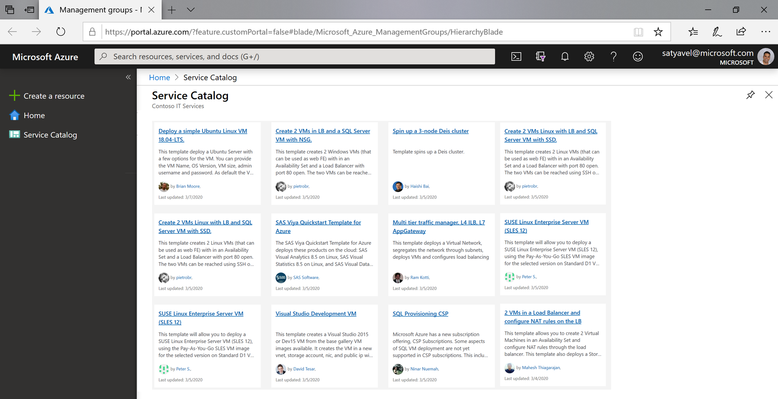
ARM Deployments |
Author
Validate
Deploy
Manage
Service Catalog
Easily publish and manage artifacts for their app teams.
Artifact Sharing: share company best-practice TemplateSpecs, VM Images, Container Images, and Binaries to an app teams service catalog.
Artifact Versioning: publish new versions of your artifacts to a service catalog in a 1-to-many operation.
Service Catalog Aware UI Experience: limit app teams to deploy artifacts through only their service catalog’s UI and CLI.
Service Now Integrations: artifacts can be surfaced in the SNOW Service Catalog and deployed via the SNOW portal.
Multi-tenant Support: a CSP can share and publish versions of service catalog artifacts across multiple tenants.
Notes:
Service Catalog (Managed Apps) vs. Service Catalog (Multi-tenant Artifact Sharing)
-

Slide 44
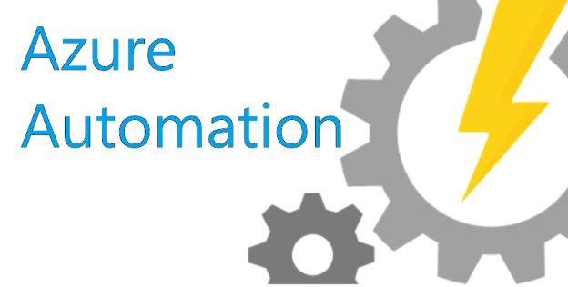
Configuration Management

Slide 45
IT is transforming
Adopting new cloud technologies
Developers
API
ARM
Templates
Scripting
Functions
Event Grid
IT
Ops
Business
DevOps
Changing operating model
Security
Developer Collaboration
Business value
Time to market

Slide 46

Azure Security & Management
Built-in Azure services options to keep your Azure and hybrid resources secure and well-managed
Governance
Security
Monitoring
Resiliency
Automate
Proactively apply policies and optimize cloud spend
Industry leading Security with Advanced Threat Protection
Deep operational insights with rich intelligence
High availability and protection for VMs, apps and data
Powerful scripting, configuration and update management

Slide 47
Single pane of glass for hybrid management
Built-in management starts in Azure and extends across operating systems and environments
Built-in
Windows or Linux
Any cloud or on-premises
Full end-to-end management support built natively into your processes, not as an afterthought
Across OS types and distributions
Across Azure, other clouds, and on-premises servers

Slide 48
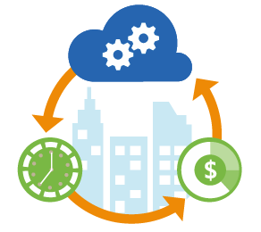
Azure Automation
What is it?
Azure Automation is a service that allows you to automate the creation, deployment, monitoring, and maintenance of resources in your Azure environment and across external systems.
Process Automation
Update Management, Change Tracking and Inventory
Configuration Management
Automate frequent, time-consuming, and error-prone management tasks
Runbooks: PowerShell, Python and graphical
Manage O.S. updates for Linux and Windows
Track configuration changes on files, registries, daemons, services and software
Desired State Configuration. Monitor and automatically update machine configuration across physical and virtual machines, Windows or Linux, in the cloud or on-premises
Notes:
What is Azure Automation. Azure Automation is a service that allows you to automate the creation, deployment, monitoring, and maintenance of resources in your Azure environment and across external systems. It uses a highly scalable and reliable workflow execution engine to execute tasks. Applications or services that have an API or understand PowerShell can use Azure Automation, allowing you to easily integrate both on-premises and 3rd party systems. Automation also includes integration into many Azure services such as; Web Sites (management), Cloud Services (management), Virtual Machines (management and WinRM support), Storage (management) and SQL Server (management and SQL support).
[EDITOR] TWB_Trevor:
09 October 2013 It seems odd to use “finally” here, given that this is not a long process – or, at least, has not been described in great detail. Kindly consider removing it, or replacing it with something that clarifies context.

Slide 49
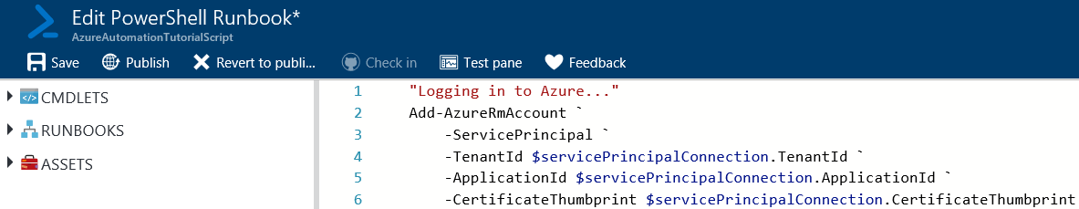
What is a Runbook
In Azure Automation, a Runbook is a file that contains a set of procedures and operations.
Runbooks are used as input for the Azure Automation service to process.
There are several types of runbooks: PowerShell, Graphical, PowerShell Workflow or Python
PowerShell Workflow is a PowerShell extension that allows you to run a PowerShell script on multiple devices in parallel with added functionality such as checkpoints, suspend & restart.
Notes:
What is a Runbook. In Azure Automation, a Runbook is a file that contains a set of procedures and operations. Runbooks are used as input for the Azure Automation service to process. They contain the tasks that are to be automated by the Azure Automation service. You can think of a Runbook as the batch file or script to your Windows task scheduler job. The contents of a Runbook file is written using PowerShell or PowerShell Workflow commands. PowerShell Workflow is a PowerShell extension that allows you to run a PowerShell script on multiple devices in parallel with added functionality such as checkpoints, suspend & restart in the event of failure. These functions are not available in PowerShell alone and are very useful to have.
[EDITOR] TWB_Trevor:
09 October 2013 It seems odd to use “finally” here, given that this is not a long process – or, at least, has not been described in great detail. Kindly consider removing it, or replacing it with something that clarifies context.

Slide 50
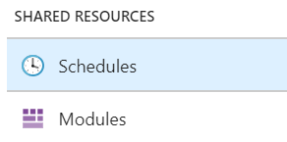
Start a Runbook
There are 7 different ways in which you can start a Runbook.
Azure Portal
PowerShell
Azure Automation API
Webhooks
Respond to Azure Alert
Schedule
From Another Runbook
Notes:
Start a Runbook. There are 7 different ways in which you can start a Runbook. The options that you have available are:
Azure Portal
PowerShell
Azure Automation API
Webhooks
Respond to Azure Alert
Schedule
Or From Another Runbook
The most common methods in use today are schedule, PowerShell, the Azure Portal and Webhooks.
[EDITOR] TWB_Trevor:
09 October 2013 It seems odd to use “finally” here, given that this is not a long process – or, at least, has not been described in great detail. Kindly consider removing it, or replacing it with something that clarifies context.

Slide 51
Process Automation - Use Cases
Use an Azure Monitor alert to trigger an Azure Automation runbook
Start/Stop VMs during off-hours
Scale an Azure SQL DB based on performance
Call an Azure Automation runbook from a Log Analytics alert
Deploy an Azure Resource Manager template in an Azure Automation PowerShell runbook

Slide 52


Update Management Challenges
Managing diverse environments
Hybrid – on prem and in the cloud
Across operating systems
Managing updates at scale
Enabling centralized compliance, distributed management

Slide 53
Microsoft Update Solutions
System Center Configuration Manager
Windows Client/Server
Optimized for On-Premises
Microsoft Intune
Windows Client
Devices
Azure Update Management
Windows Server/Linux
Optimized for Cloud and Hybrid

Slide 54
Azure Update Management
Assess update status of servers across your environment
Windows, Linux
Azure, other cloud, on-prem
Deploy updates
Select updates classifications to be applied and have exclusions
Create maintenance windows
Single pane of glass
Automated periodic deployments
Verify update compliance across your environment
Free for all environments*​
first 5GB/month of Log Analytics inbound data
Verify Compliance
Assess Updates
Deploy Updates

Slide 55
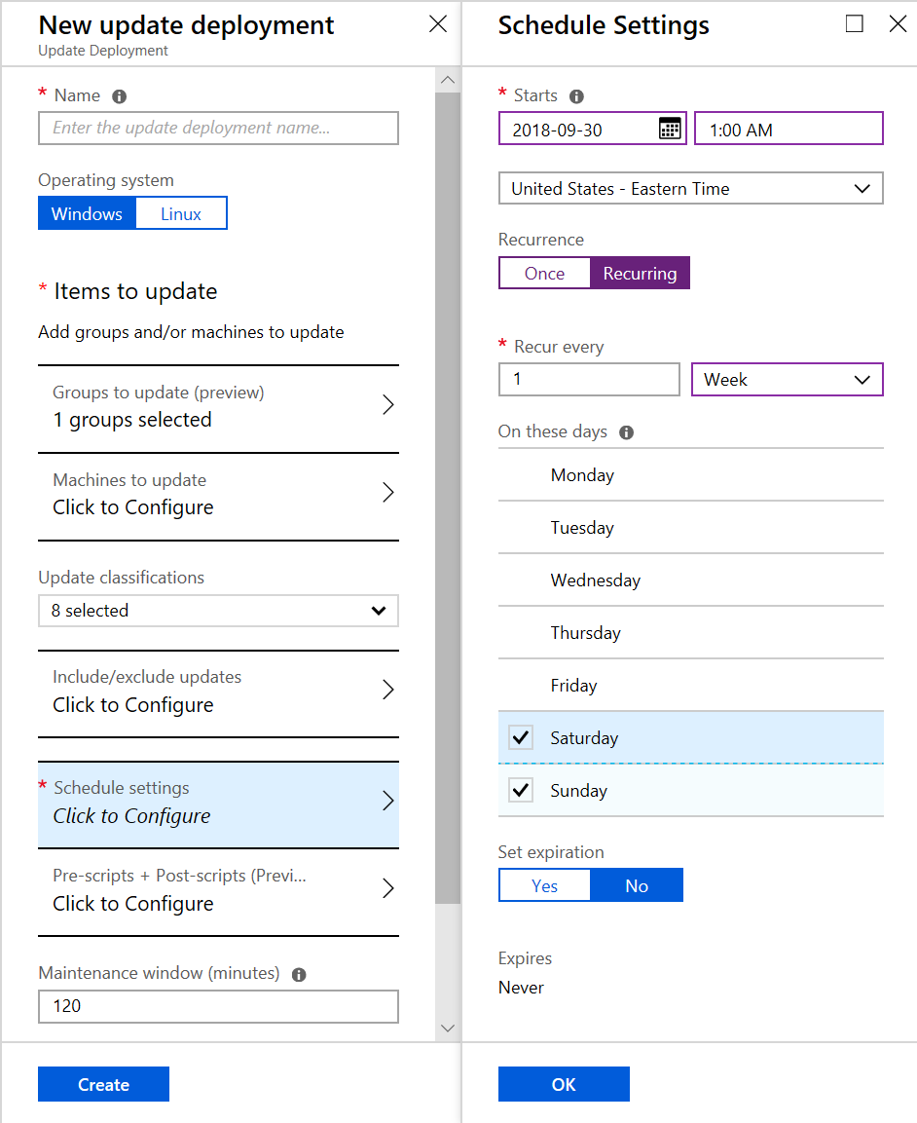
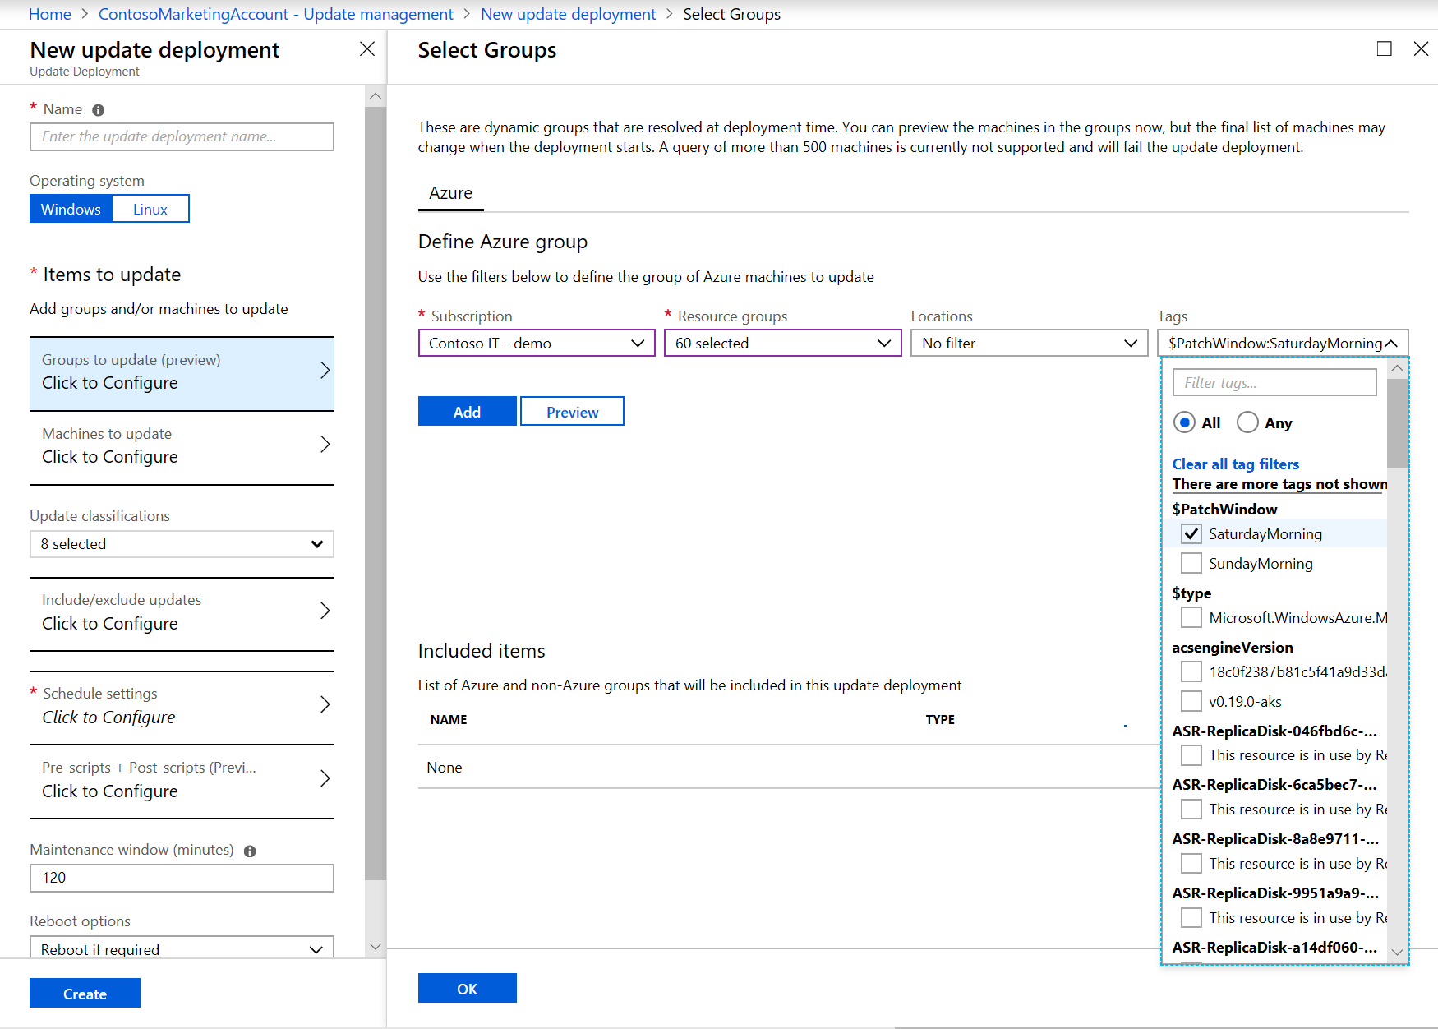
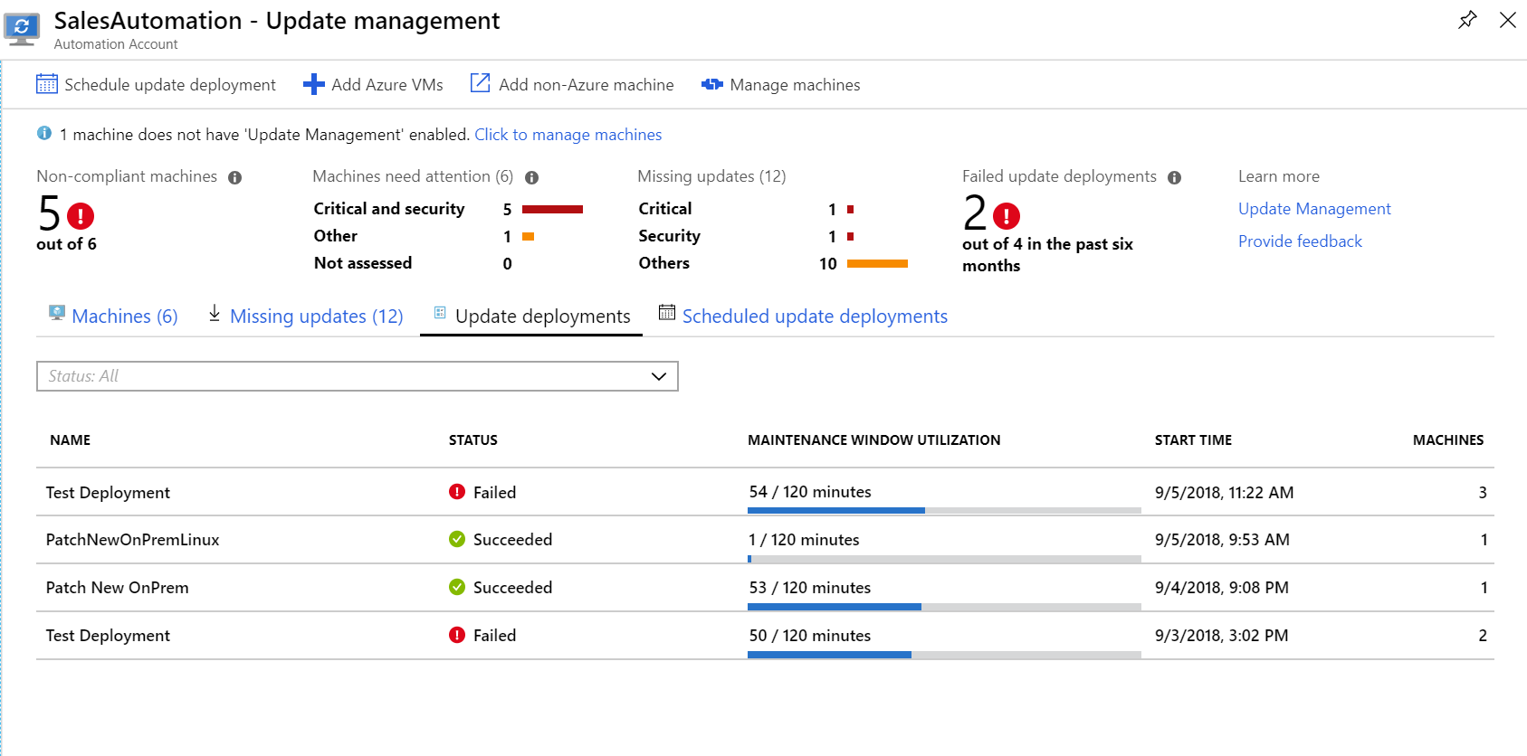
Easily deploy updates
Schedule one-off or recurring updates
Flexible targeting options
Target systems by name, imported groups, or custom query
Dynamically target Azure VMs
Track in-progress and past deployments

Slide 56



How it works: Update and Assessment Lifecycle – Azure VM
Monitoring agent deployed
VM1
Log Analytics
Update management enabled
Management pack
Assessments/Status
Monitoring Agent
Hybrid worker role
Port 443
UpdateMP
Periodic assessment
Azure Automation
Update deployment
Update Job
Port 443
Hybrid Worker
Firewall – port 443
https://aka.ms/lanet
https://aka.ms/autonet
Azure
vnet
Notes:
Hybrid Runbook Worker feature of Azure Automation to run runbooks directly on the computer

Slide 57



Assessment: Enrichment and Normalization
Package
Repositories
Linux Vendors
Linux Server
Security bulletins
Yum/apt-get/zipper
Azure Update Management
Available updates
Available updates
Management Agent/DSC
Enriched update data
Azure

Slide 58
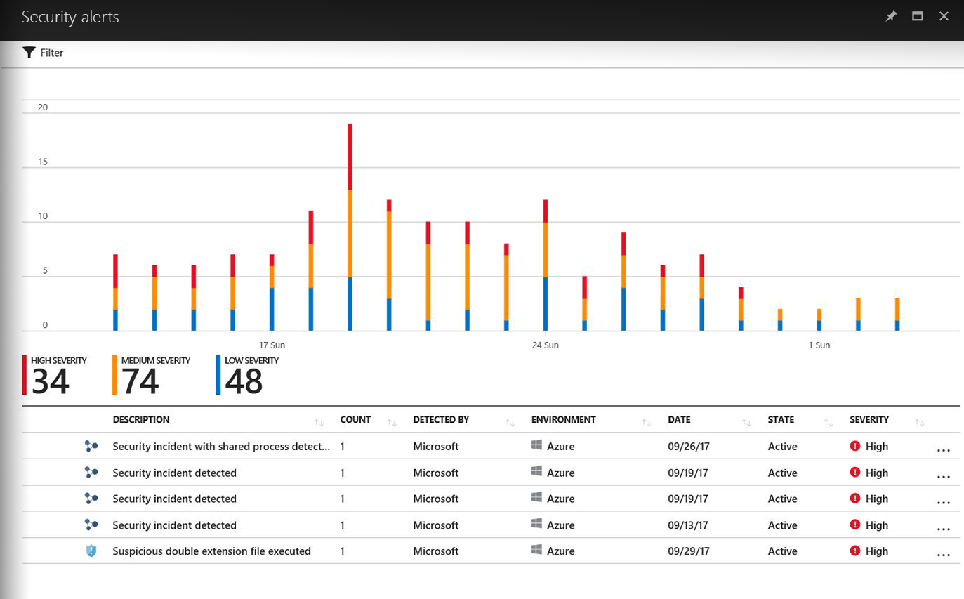
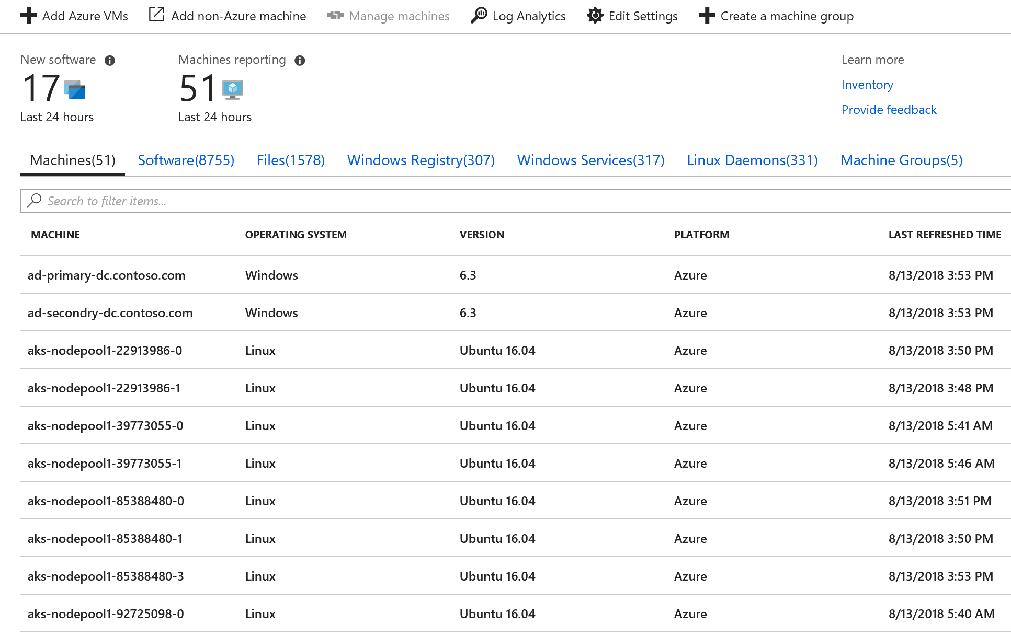
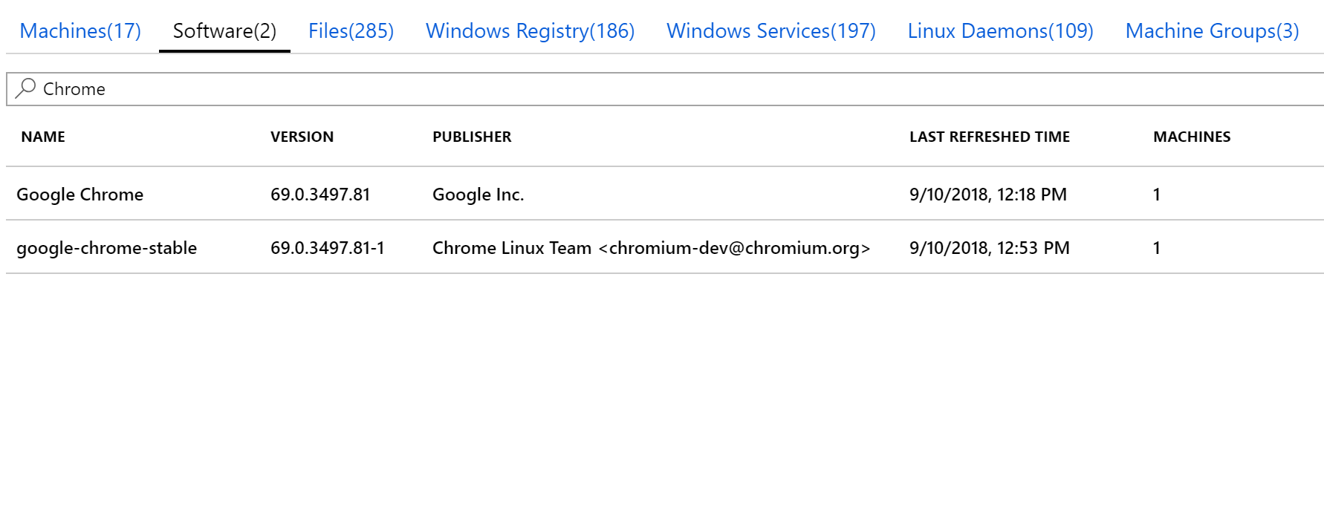
Inventory Discover the state of your environment
Discover what's installed on your machines
Software
Services/Daemons
Files
Registries
View how many machines have a specific software or version
Updated when a change is detected
Inventory

Slide 59
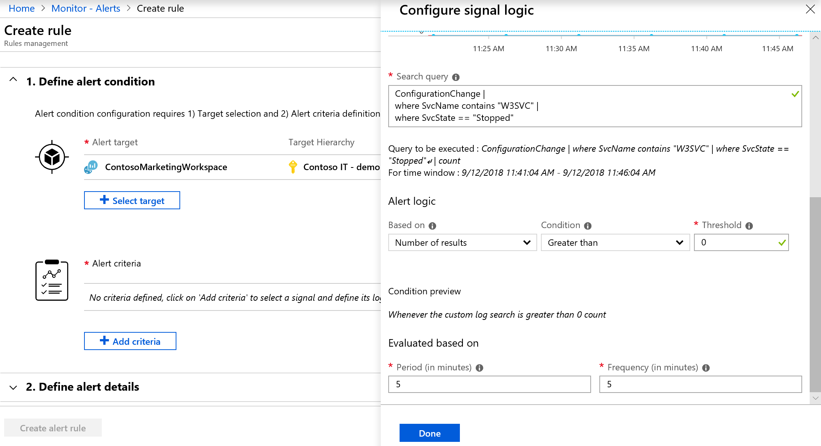
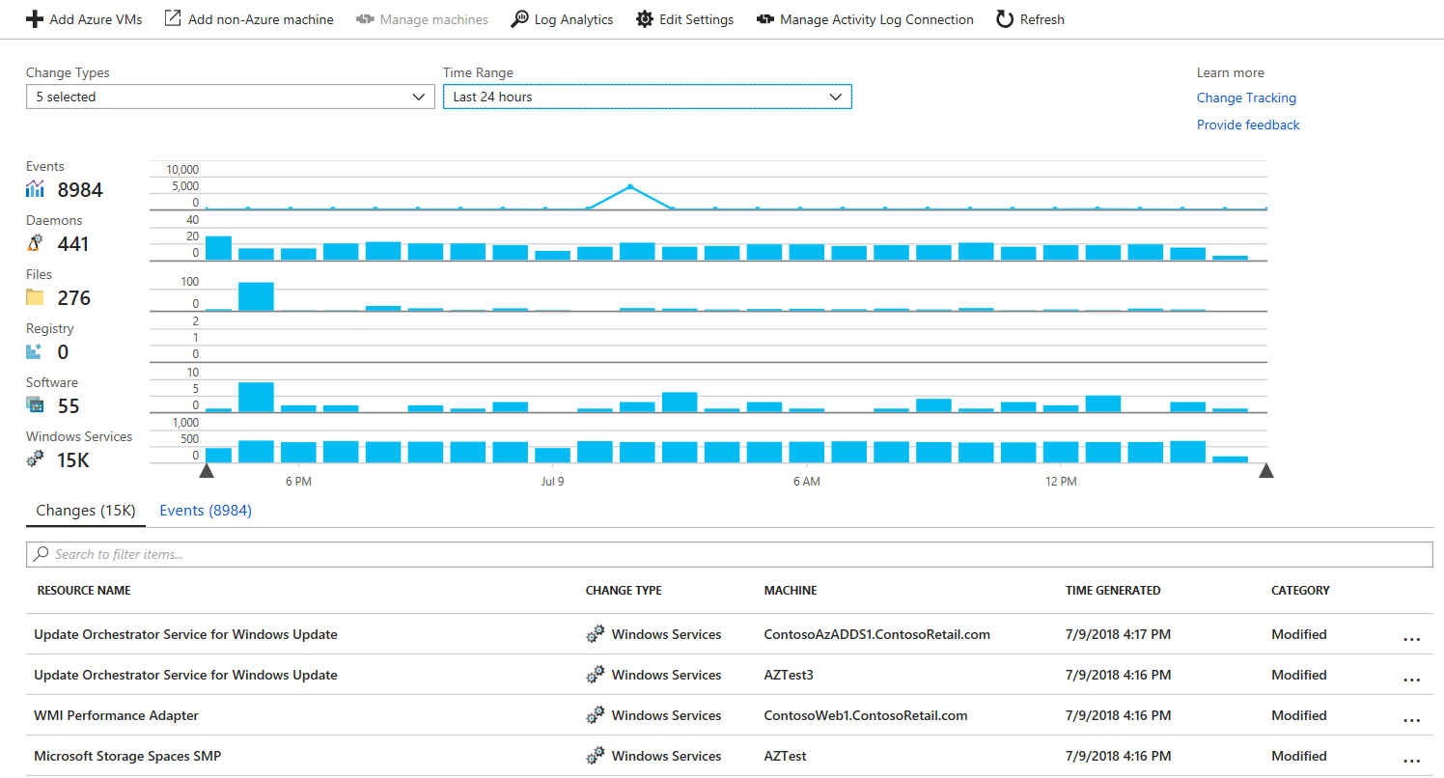
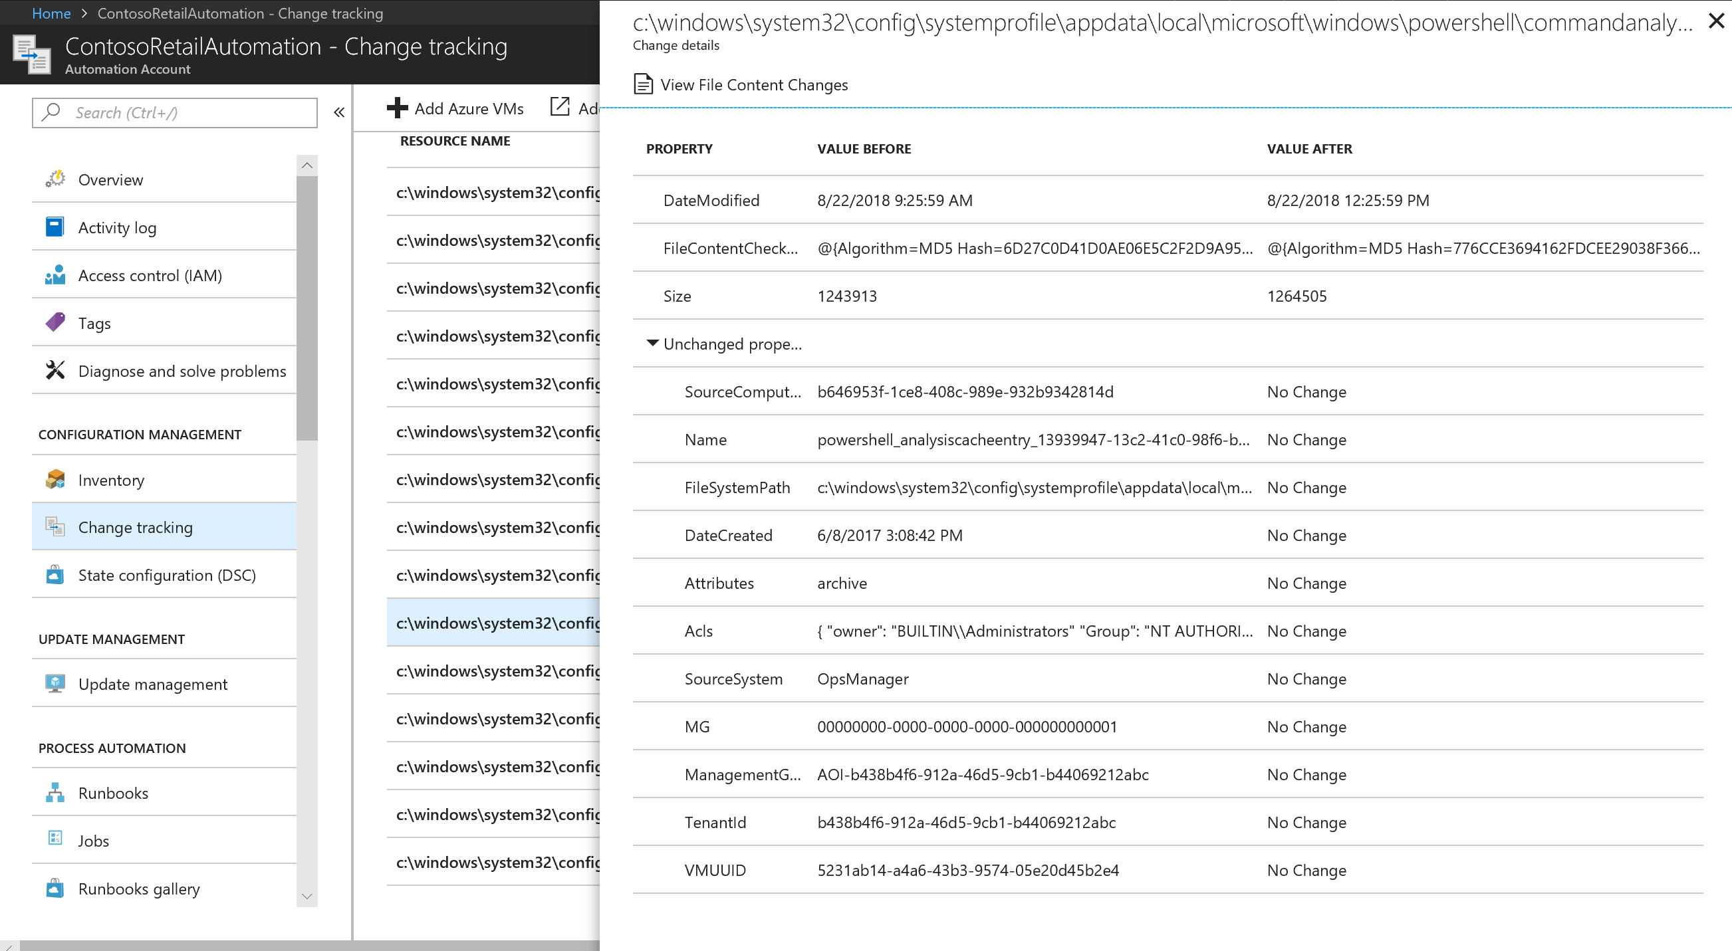
Change Tracking Detect server changes
Detect changes to your machines
Software
Services/Daemons
Files
Registries
View changes when troubleshooting
Alert on critical changes
Difference in Inventory snapshots
Change Tracking

Slide 60
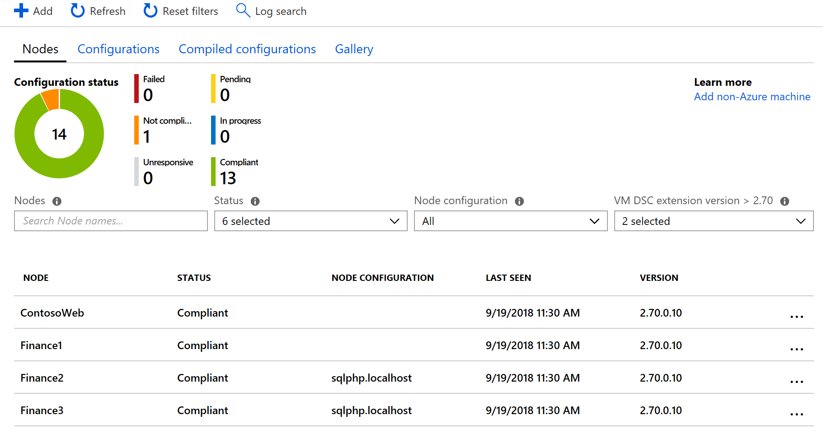
Configuration Management (DSC) Set and control your configuration as code
Configuration Management
Manage the configuration of your operating system and application settings
View compliance reports at scale from across your environment
Centrally store configurations and dependent modules

Slide 61

DevOps

Slide 62
What is DevOps?
Develop
“
DevOps is the union of people, process, and products to enable continuous delivery of value to your end users.
”
DevOps
Operate
Deliver

Slide 63
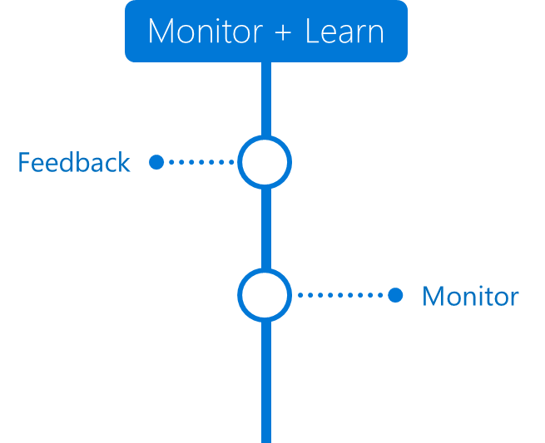
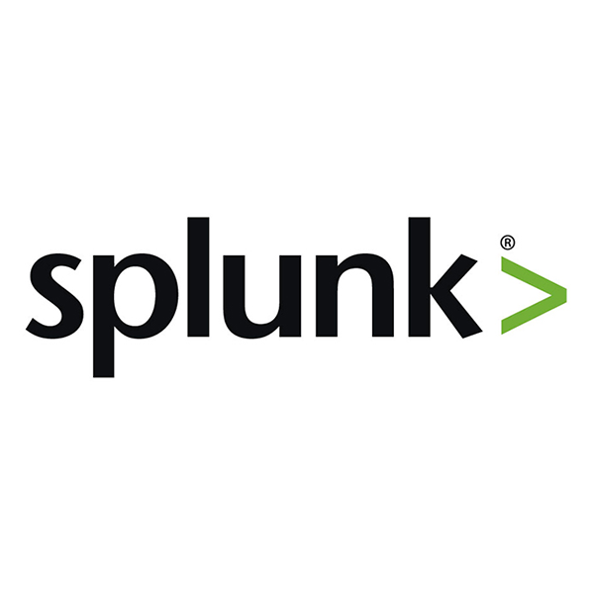
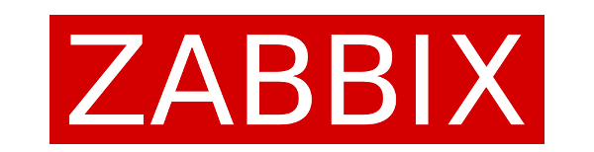
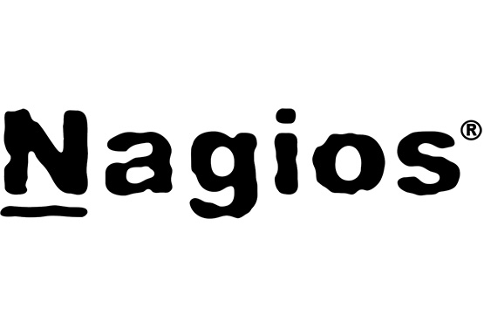


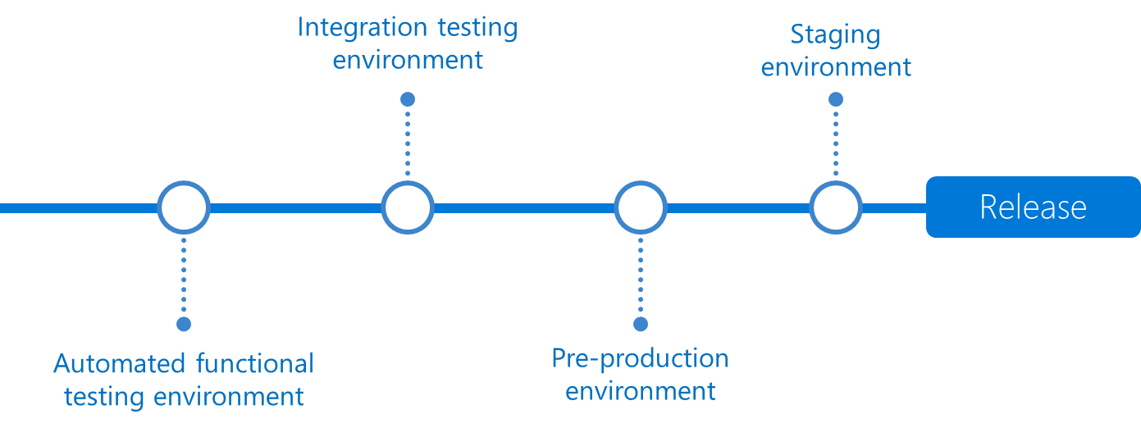



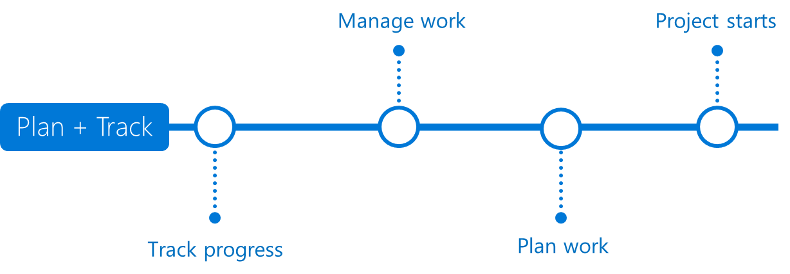






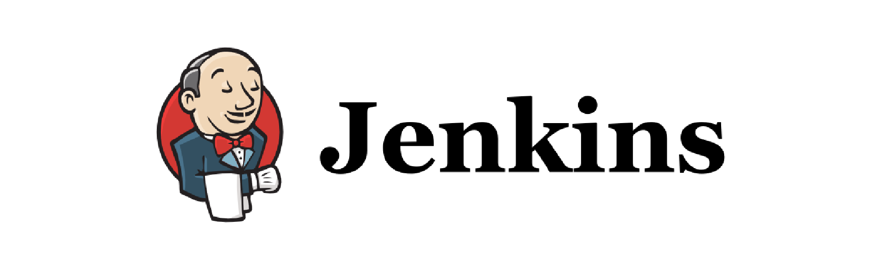
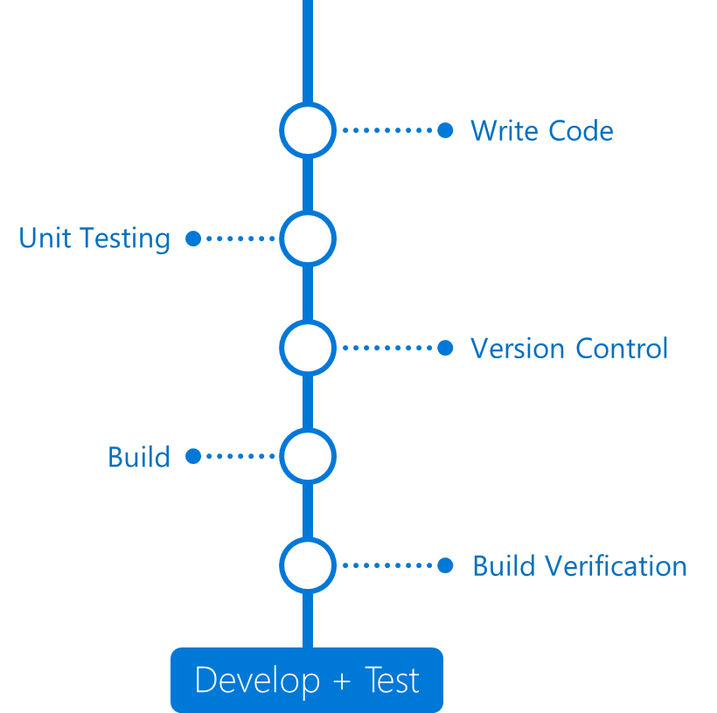

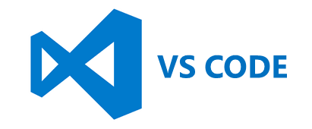

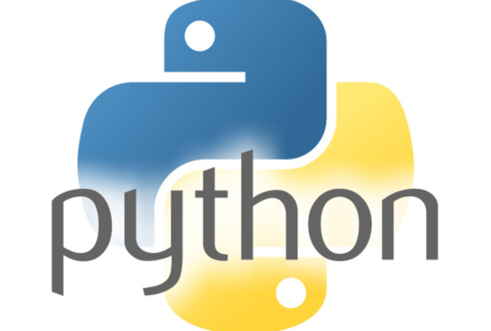








DevOps = Products
DevOps
DevOps

Slide 64




Why DevOps?
200x more frequent
deployments
2,555x shorter time
to market
3x lower
change failure rate
24x faster recovery
from failure
DevOps Report 2016

Slide 65

Azure DevOps + GitHub
Azure Boards
Azure Repos GitHub
Azure Test Plans GitHub Adv. Security
Codespaces GitHub Mobile
Microsoft Azure is the cloud with developer services built in
GitHub is Native DevOps platform built on the planet’s code-base
Azure Monitor
Azure Security Center
GitHub Insights
Azure Pipelines GitHub Actions
Azure Artifacts GitHub Packages
GitHub Adv. Security
Notes:
Now we transition from talking about GitHub.com to GitHub Enterprise.
Organizations that make a strategic investment on GitHub and Azure will benefit from GitHub’s unique position in the market as the home for open source allowing innovation across traditional DevOps capabilities and into new areas including advanced security and insights.
GitHub takes a truly holistic approach to securing the software supply chain, from maintainer through enterprise developer and into deployed code. GitHub believes that it is incumbent on developers, enterprises, security professionals and researcher to work together to secure software and their investments in Dependabot and automated code scanning show a continued commitment to simplifying vulnerability identification and reducing time to radiation.
*pause* (if you feel your customer would benefit from this following additional talk track, proceed)
GitHub Advanced Security
Security advisory workflows
Vulnerability scanning and remediation
Dependency Insights
Semantic code search
Additionally GitHub will be adding capabilities around actionable insights to help organizations optimize their processes, benchmark against industry leaders and accelerate software delivery.
GitHub Insights
Organizational Insights
CI/CD insights and benchmarking
Dependency Insights
Finally GitHub will continue to invest in DevOps capabilities such as planning to provide a full code-to-cloud solution.
Similar to how GitHub Actions are built on the foundation of Azure Pipelines we are exploring how to bring the best of Azure Boards into GitHub. (Added by Dave Burnison on 1/28/2020)
GitHub Projects: https://github.com/features/project-management/

Slide 66

Template-Orchestrated Deployment
Notes:
The other deployment option is Template-Orchestrated Deployment. This is where ARM Templates come in and make this the best approach for deploying resources in Azure. This process is more repeatable and flexible, which is what we want, especially when automating.
This is the officially supported approach for deploying resources in Azure. The template language is constantly evolving. Documentation and best practices, as well as huge code base with examples is publicly available.
Using this approach, it is easier to read the pipeline itself, as it has minimal number of steps.
By default, deployment of different components happens in parallel (faster) - this orchestration feature is natively provided by ARM itself (you don't have to define how to execute the steps).
Deployments can be serialized using multiple, separate steps/stages in the pipeline if needed (e.g. shutting down the VM before changing managed disk type from Standard to Premium, then starting it again).
Sensitive values can be natively read and passed through within the master template (=secure).
Easily portable to another CI/CD platform, as the deployment logic is self-contained within the master template.
In case of very complex deployments, a master template can have too many parameter values and limitations can be hit - then objects have to be used as parameters. Note: it is not even mandatory to use parameters in the master template. With hard-coded values, it can be made completely self-contained (the flexibility that using parameters can provide, is already implemented in the modules).
Complexity at 2 places: Even though, the logic mainly exists in the master template, in case of very complex deployments, some steps (part of the logic) may have to be created in the pipeline.
DevOps team has to have deep ARM knowledge to edit templates.

Slide 67


GitHub Actions: Powerful, flexible CI/CD
Natively integrated with GitHub
Code, collaboration, packages, and CI/CD - all in one place for your developers
Automated workflows with Azure
GitHub Actions for Azure with native support for deployments to Azure Kubernetes Service, Azure Web Apps, Azure Container Registry, and more planned
Accelerate with your preferred languages and environment
Any language plus your choice of package format. GitHub-hosted runners on Windows, Linux, and MacOS, with x86 and ARM for self-hosted runners
Notes:
Natively integrated with GitHub - Code, collaboration, packages, and CI/CD - all in one place for your developers
Automate any development workflow - Trigger workflows off nearly any event in the GitHub ecosystem
Accelerate with your preferred languages and environment - Any language plus your choice of package format. GitHub-hosted runners on MacOS, Linux, and Windows, with x86 and ARM for self-hosted runners
Scale easily on any cloud - Planet-scale CI/CD runs on and deploys to any infrastructure, and any cloud

Slide 68


Secure, scalable enterprise workflow automation
End-to-end traceability + governance
Plan and track work in Azure Boards linked to GitHub, and monitor your code deployed to Azure from GitHub Actions
Scale best practices with code
Define and scale processes, security, and compliance policies for your organization, across teams, repos, and throughout the software lifecycle
Unified authentication
Sign into Azure with your GitHub credentials and authenticate to GitHub Enterprise with Azure AD

Slide 69

GitHub Actions
Workflow: unit of automation from start to finish, including triggers, environment or aspects to be considered during the automation
Job: a section of the workflow and is made up of one or more steps.
Step: A step represents one effect of the automation, could be a GitHub Action, or another unit, like printing something to the console.
Action: a piece of automation written in a way that is compatible with workflows.

Slide 70


GitHub Actions for Azure Over 70 ready-to-use actions for Azure
Deployment actions to Azure include:
Deploy to Kubernetes Cluster – deploy a Kubernetes cluster, including AKS clusters
Azure WebApp – deploy Web Apps or Containerized Web Apps to Azure.
Azure Functions Action – deploy Function App to Azure Functions.
Azure SQL Deploy – deploy a DACPAC or a SQL script to Azure SQL Database
Azure Machine Learning Deploy – deploy a registered model in your Azure ML Workspace
Other popular Azure actions:
Azure CLI – automate your workflow by executing Azure CLI commands to manage Azure resources inside of an Action
Azure Key Vault – get secrets from Azure Key Vault instance and set as output variables.
Azure Policy Assignment with Azure CLI - apply a policy to new infrastructure using Azure Policy (HIPAA, PCI-DSS, etc).
and many, many more…

Slide 71
//TODO
Azure Policies – DevOps
Security as Code
¿Demos?
Bicep
Azure Policies in ADO Release Management
Azure Image Builder from GitHub Actions
Azure/Ignite2019_IaC_pre-day_docs: Ignite 2019 Infrastructure as Code pre-day docs (github.com)

Slide 72
Challenge
Get your machine ready
Configure Terraform on Linux subsystem, credentials
"Hello World" Terraform
Create an Azure resource group using Terraform / Bicep
Deploy a Virtual Network
Learn how to find Terraform HCL syntax to deploy an Azure resource / how to use Bicep
Open Some Ports
Learn about variables, dependencies, idempotency
Create a Linux Virtual Machine
Learn what an Azure Virtual Machine is composed of
Use Image Builder to Create a Linux image with NGINX installed
Learn about custom build images with Image Builder
Create a Pipeline/Action that rule them all

Slide 73






Innovate programmable, automated management
IT as Code narrowing the gap between developers and IT
Declarative Approaches
Cloud Center of Excellence (CCOE)
Infra as Code
Policy as Code
Config as Code
Role based access as Code
Provision Tenant Infra
Assign Policies
Assign RBAC
Create Subscriptions
70%
Capabilities Provided
Day One and @ Scale
Resource Provider coverage from day one and ability to do large scale multi-region deployments
# of all resource created declaratively monthly via ARM Templates
Simplify Authoring
Automated Template generation via Azure Portal
VSCode extension with intellisense, snippets etc.
Provision and manage the lifecycle of resources in a declarative way
Environment Setup
App Team/DevOps
Create Pipelines
Deploy App Infra
Deploy Apps
Tenant, MG and Subscription level deployments
One-click deployment solutions(Blueprints) to help meet regulations such as ISO, CIS, PCI, FedRAMP
Integrated
Azure Policy the remediations
AzDevOps and GitHub tasks
Provisioning flexibility with Terraform, Ansible, SNOW
Notes:
Cloud has evolved from disrupting IT markets, to it now underpinning most next-generation emerging technologies, reshaping business and is paving the way for advanced use cases. Today, Hybrid/multi-cloud is a primary element of IT transformation as customers transition from traditional environments to multiple cloud providers. As cloud-native technologies enter into IT environments they are creating a new landscape for IT operations and complexity.

